Slide 1

Notes:
Joe B

Slide 2
Modern Work Team - Heartland Business Systems
25 Years in IT, 19 Years in Microsoft Stack, 3 Years IT Instructor
SharePoint On-premises Stand-ups and Rescues
Fileshare & SharePoint to Cloud Migrations, Cloud to Cloud Migrations
Azure & O365 Integrations, React Development, PowerShell
Azure Hosted LLMs, Microsoft Copilot
Healthy fear of Robots and AI since I saw "The Black Hole" at age of 3 3
Joe Baldwin
Senior Modern Work Engineer
Notes:
Joe B

Slide 3

PLEASE!
Ask Questions

Slide 4
IRPA AI and your business Now and Into the Future April 2023
NEW AITP ChatGPT/AI Roundtable May 2023
ServiceFest Creating your AI Roadmap September 2023
AI & Business
Let’s talk animals instead?
Innovate Leverage Cloud Infrastructure for Azure AI & Copilot October 2023
Microsoft Copilot Launch Event Copilot Case Study February 2024
TechConnect Era of AI May 2024
GIPAW Era of AI June 2024
HBS Sales AI In Action: Real-World Success Stories July 2024

Slide 5
What’s the Problem?
Keeping animals alive is hard (but worth it!)

Slide 6
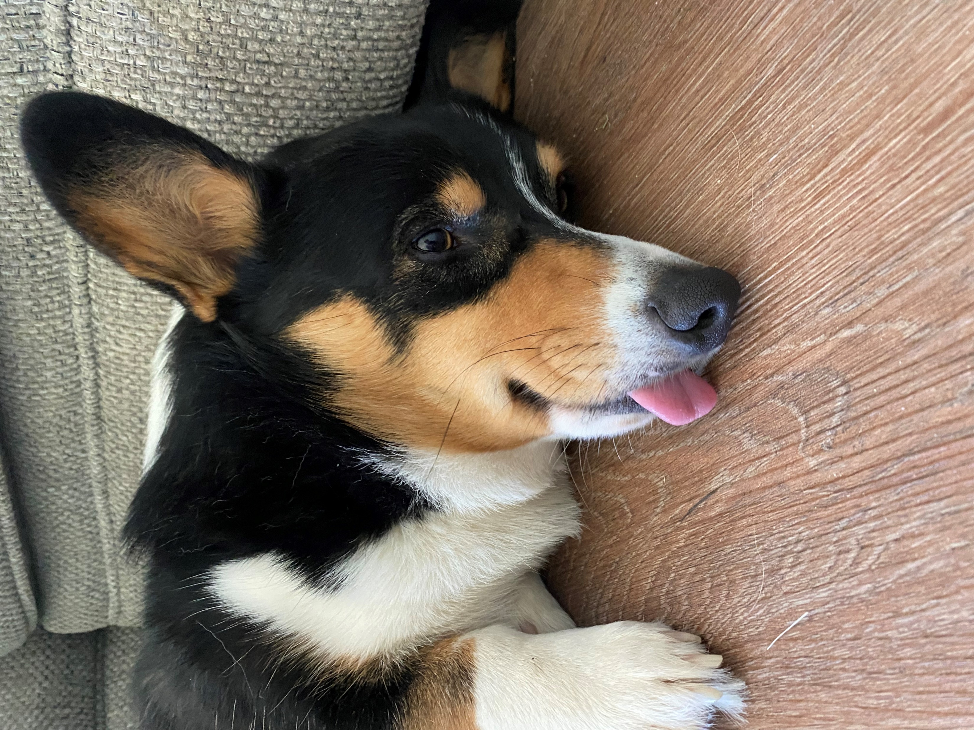
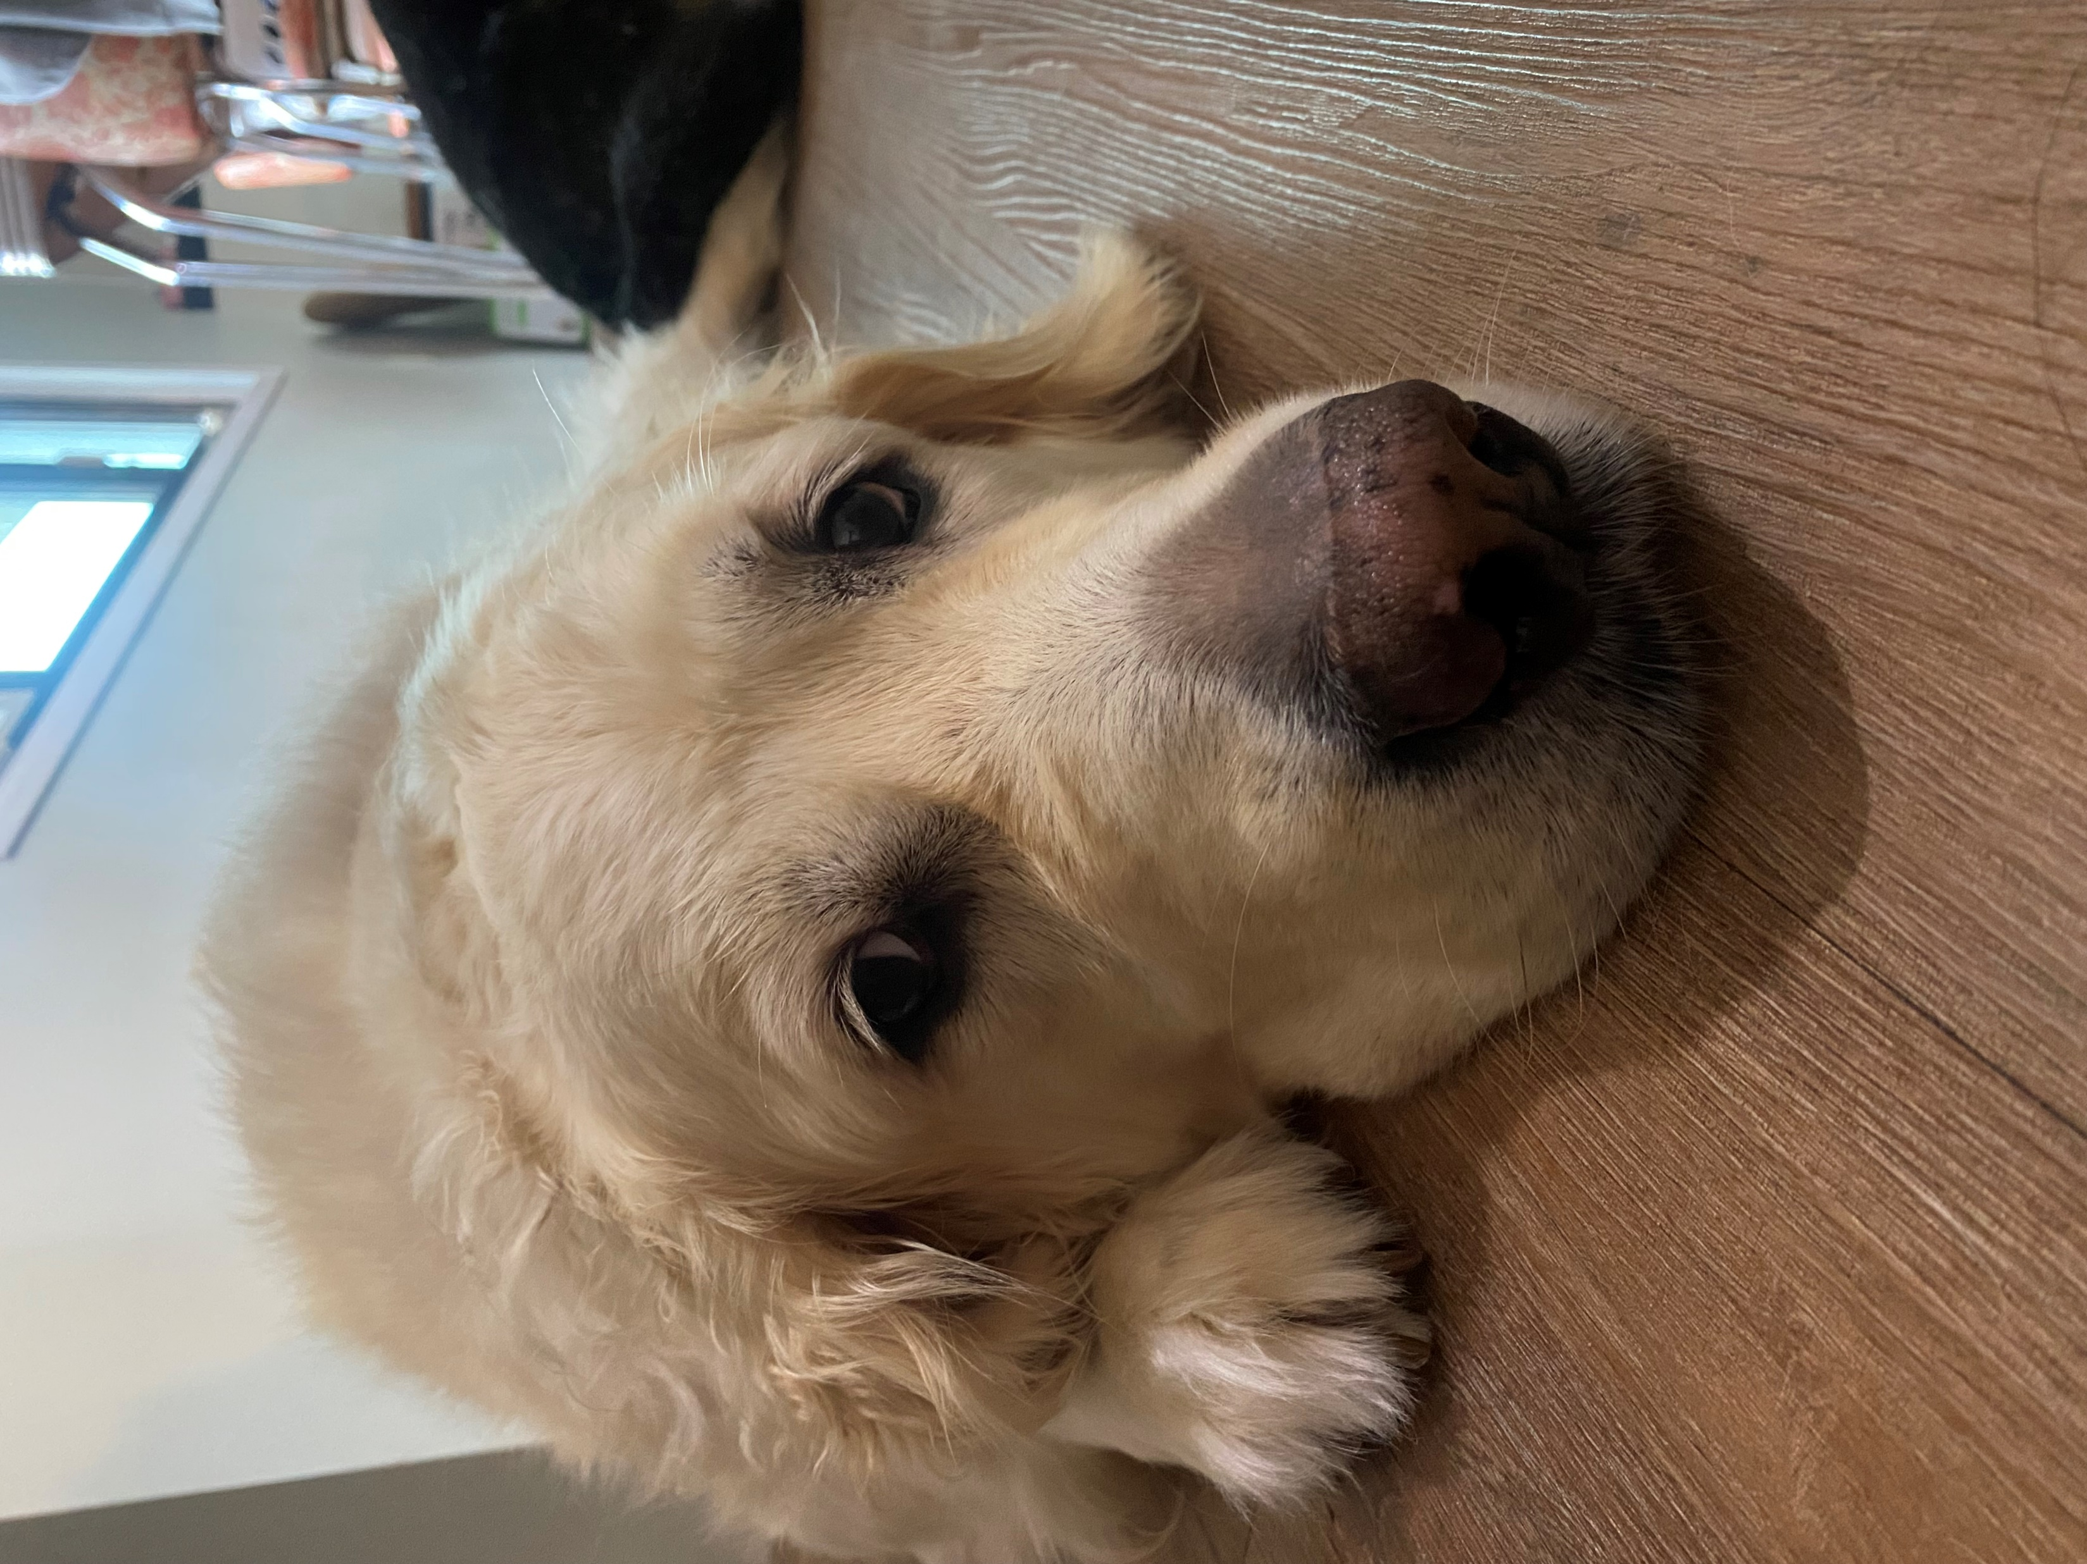
What’s the Problem?
Unmotivated workforce

Slide 7
Chickens eat less in warm weather
Cider Vinegar causes Acidosis in Chickens when added to water in high temps
Animals drink more water in hot weather
Goats don't like grazing in rainy weather
Animals stuck indoors = slobs
Chickens more likely to be broody in hot weather
Sun goes down at different times during the year
If the farm next door cuts hay the hawks come out
No problem, just do the same stuff every day?
Tasks are dependent on weather and animal behavior

Slide 8
That sounds like an excuse…
Somebody (me) might not be so great at delegating, or details.

Slide 9

What about old technology?
Big chalk board
Too much reading
Bad handwriting
No remote access

Slide 10

What about existing technology?
Forms
Too many textboxes
Not flexible

Slide 11

New Technology?
Chatbots
Too many questions!
Really not flexible.
Low engagement

Slide 12
Sure, but…
ChatGPT isn’t connected to anything. Copy and paste?
Everything is expensive
Subscriptions
Sensors
Storage
Dev time
Hosting
New(est) Technology?
I hear AI is the answer for
everything

Slide 13
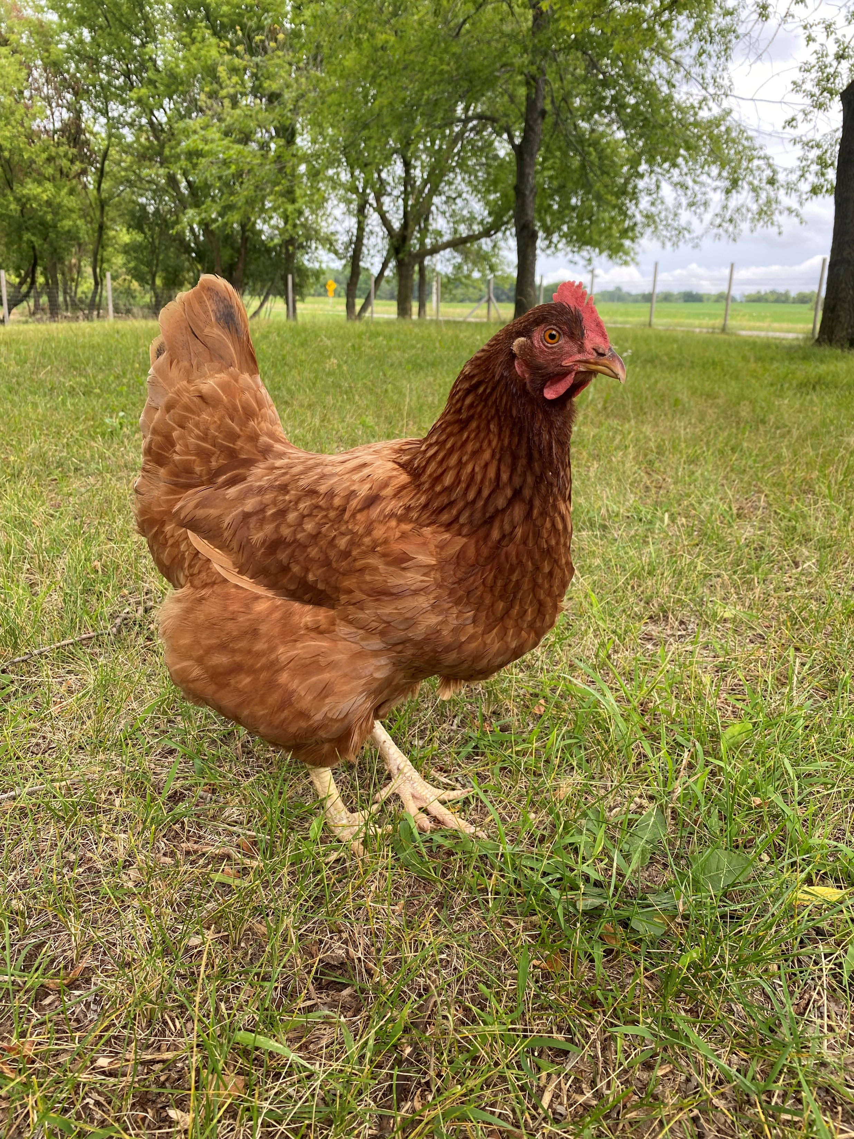
A Brief History of AI
The Players
Peggy
aka Peg
aka Peg-Peg
aka Peggers

Slide 14
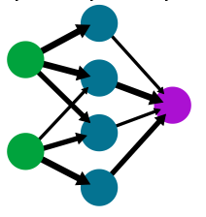
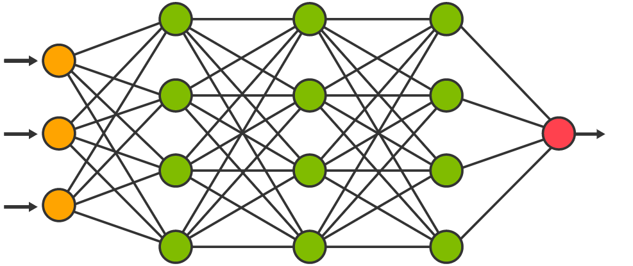
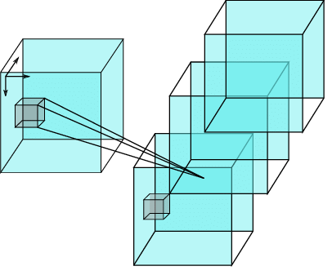
Neural Networks
In and Out of Fashion for 70 Years
1944
Single Layer
1957
First Trainable Neural Network
1980s
Algorithms for adjusting weights and thresholds in multiple layers
2000s
Large Datasets: ImageNet, Wordnet, Google CAT Experiment

Slide 15

Generative AI
Current Hype Cycle
Predictive Text
Text to Image/Video
ChatGPT, Google Gemini, Copilot
Midjourney, Dall-E, Runway

Slide 16
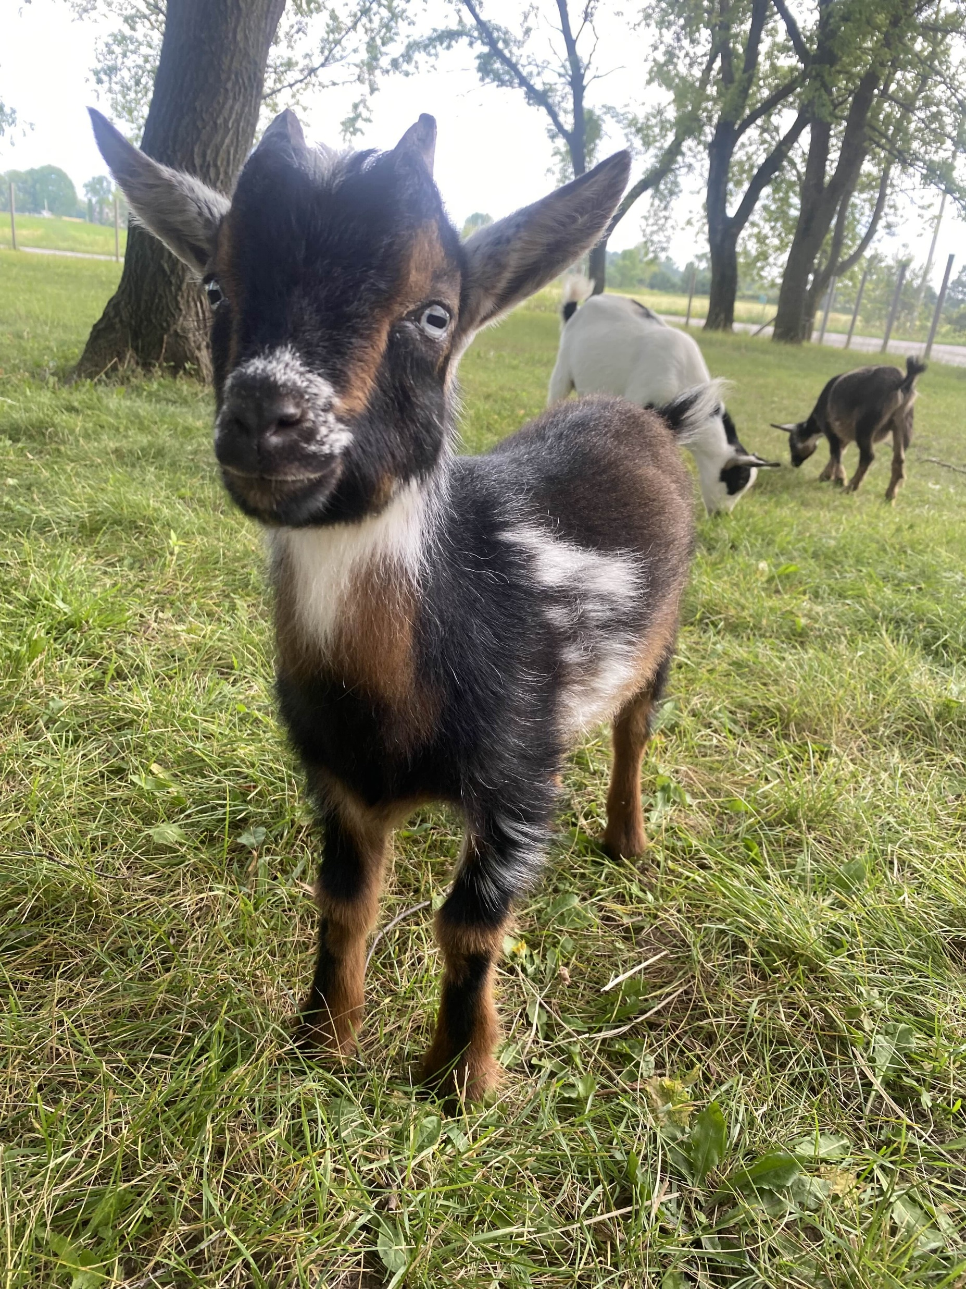
AI Assist Architecture
The Players
Timmy
Timmers
Tim-Tim
Timmy Tum-Tum
Timothy

Slide 17
AI Advance
Facial Recognition
Image Classification
Digital Twins
Quality Inspection
AI Predict
Machine Learning
AI Assist
Large Language Models
Robotic Process Automation
Speech Recognition and Generation
AI Focus Areas
What kind of AI?

Slide 18




AI Assist Architecture
AI with Data?
DATA
User
AI

Slide 19









AI Assist Architecture
AI with Data!
DATABASE
CAMERAS
REST API
LLM
BOT

Slide 20
Predictive Text in 2018,Heirloom Apples
Mage
Little Nonsy
Red The Braw
Lady Fallstone
Baldy the Pearmain
Spitzenborn
Warflush
Bogma
Red Tomm of Bonesey
Lady Of the Light
Kentic The Steeler
Warrior Golden Pippin Of Bellandfus
AI Assist Architecture
Large Language Models (LLMs)
https://www.aiweirdness.com/heirloom-apples-youve-never-tried-18-09-07

Slide 21
AI Assist Architecture
Data Sources
Cameras
Scheduled Tasks
Free Weather API
Humans

Slide 22
AI Assist Architecture
False Starts & Dead Ends
Azure Chatbots w/ LUIS
System Messages w/ JSON response
Teams Messaging Extensions
Functions with ChatGPT < 4.0
Langchain with Tools
Fine Tuning LLMs

Slide 23
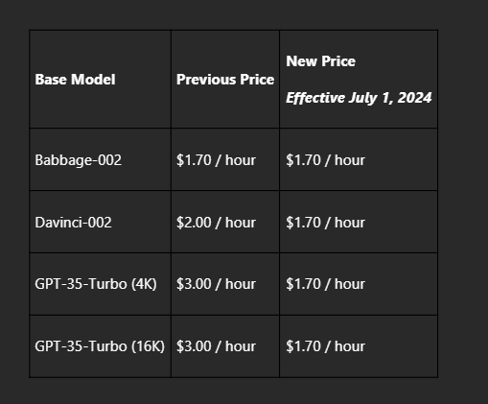
AI Assist Architecture
Azure Fine-tuned LLM pricing
$504/week vs. $285.50/week

Slide 24
AI Assist Architecture
Why Azure OpenAI?
Data Security
Azure Ecosystem
Pay-as-you-go
Cost alerts
Free Monthly Azure $$
Input Token Costs:
OpenAI: $0.000005/Token
Azure: $0.000005/Token

Slide 25
AI Assist Architecture
Building Blocks
OpenAI API version 2024-02-01 w/ Tools
Hosted Azure OpenAI GPT-4o
Nodejs (16.13.1) Express
Microsoft SQL Server (free version)
Python 3.12.1
Discord.py

Slide 26
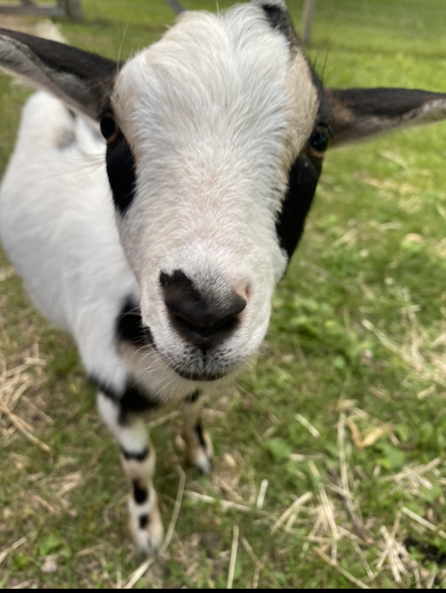
Discord
The Players
Big Mike
Michael (when he’s in trouble)

Slide 27
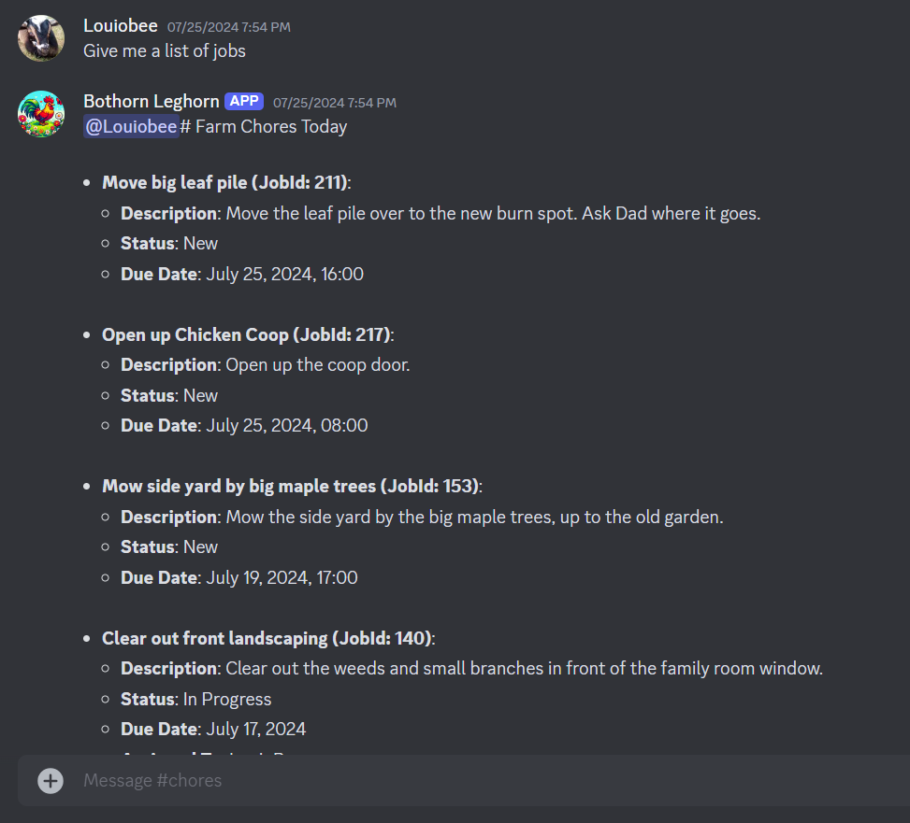
Why Discord?
Conversation Management
Authentication
Mobile Friendly
Discord.py

Slide 28
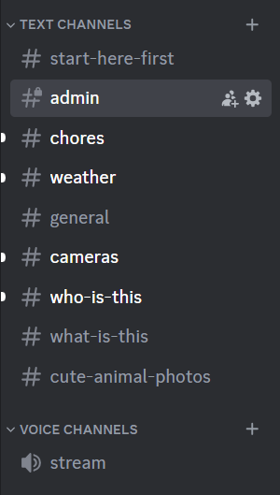
Why Discord?
Channels!

Slide 29
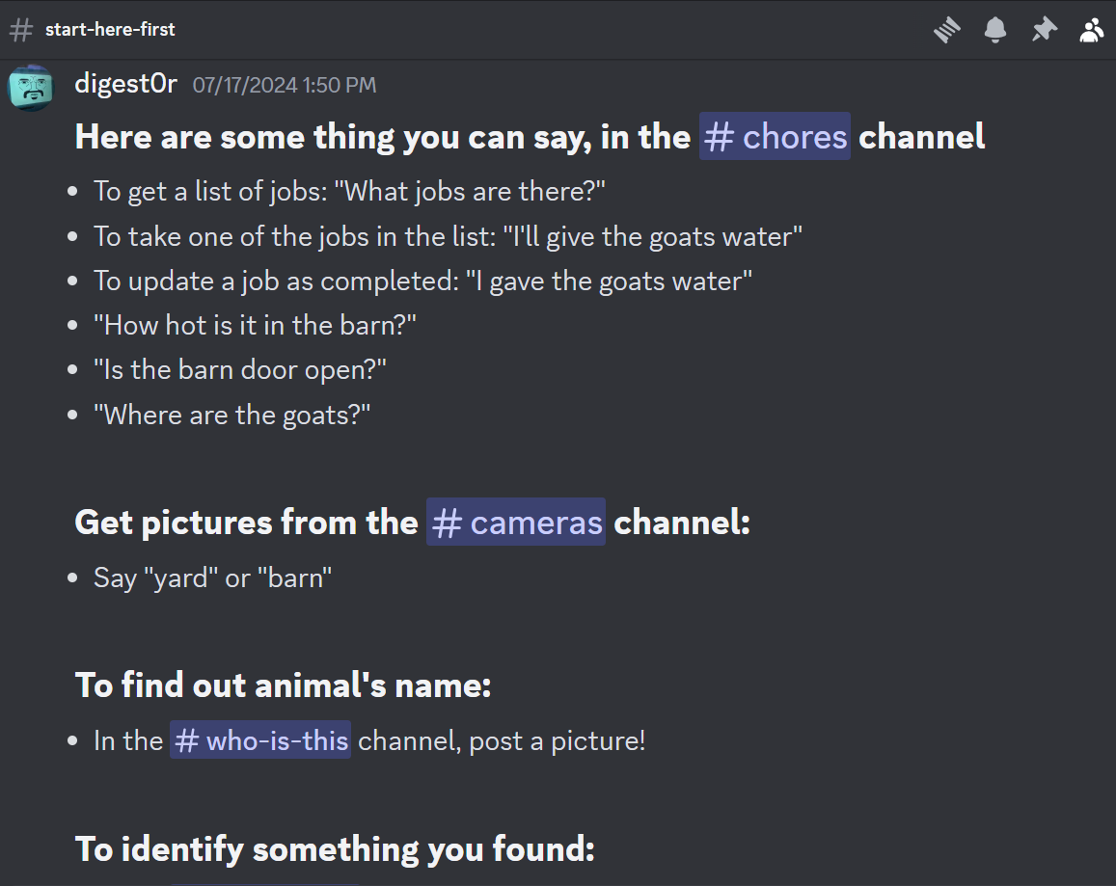
Why Discord?
Start Here First

Slide 30
Jobs List
“What jobs are there?”

Slide 31
Update Job
“Chickens got water”

Slide 32
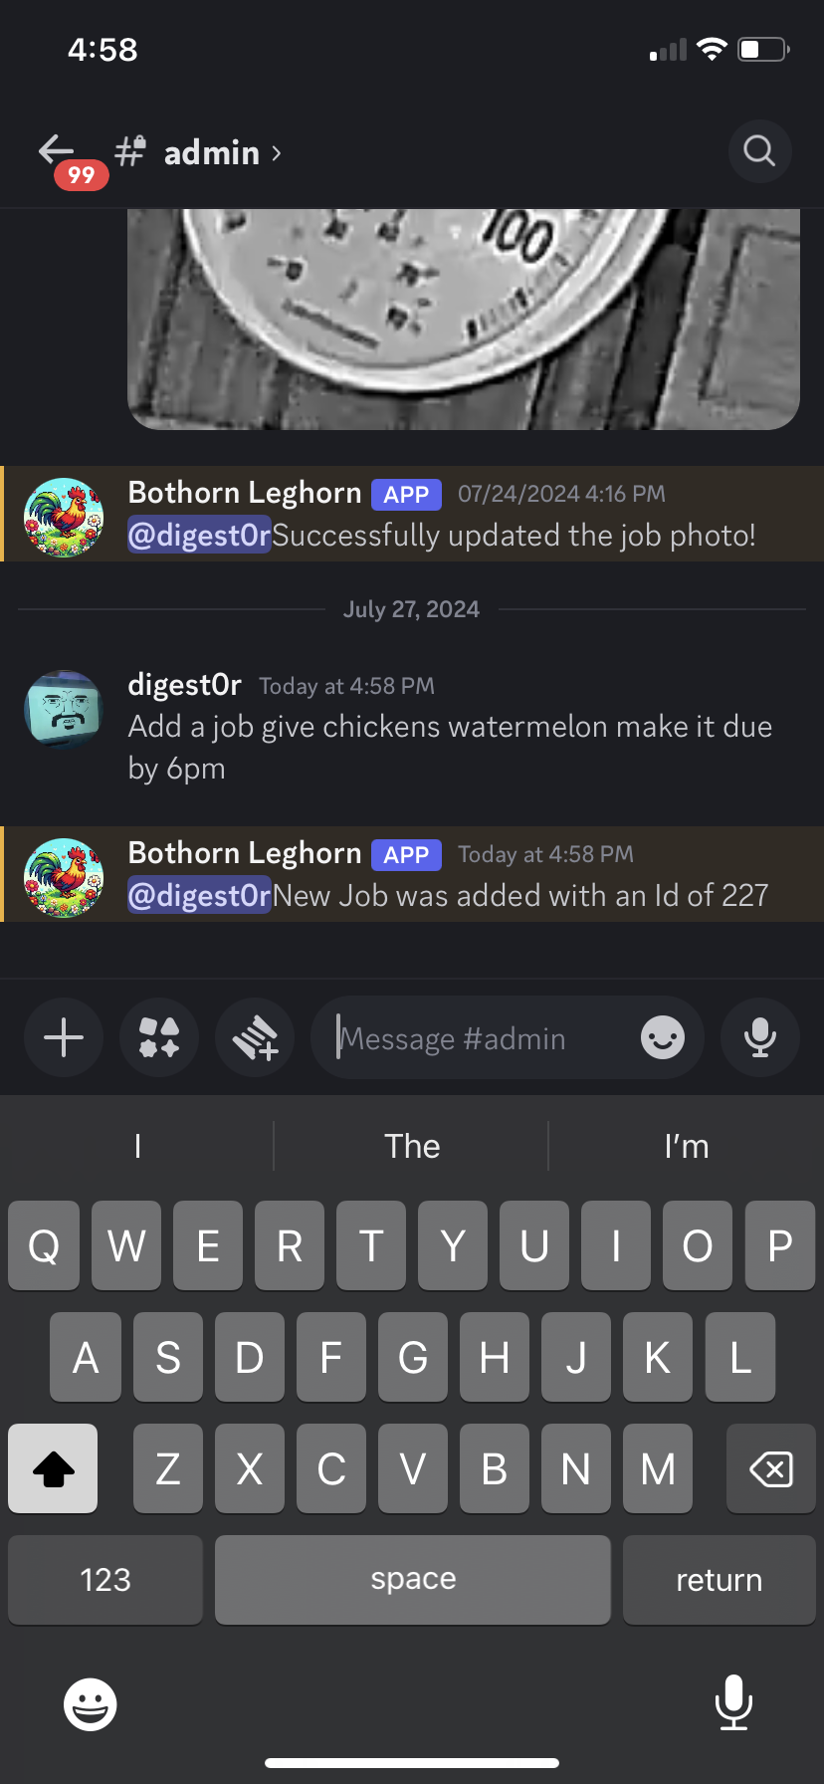
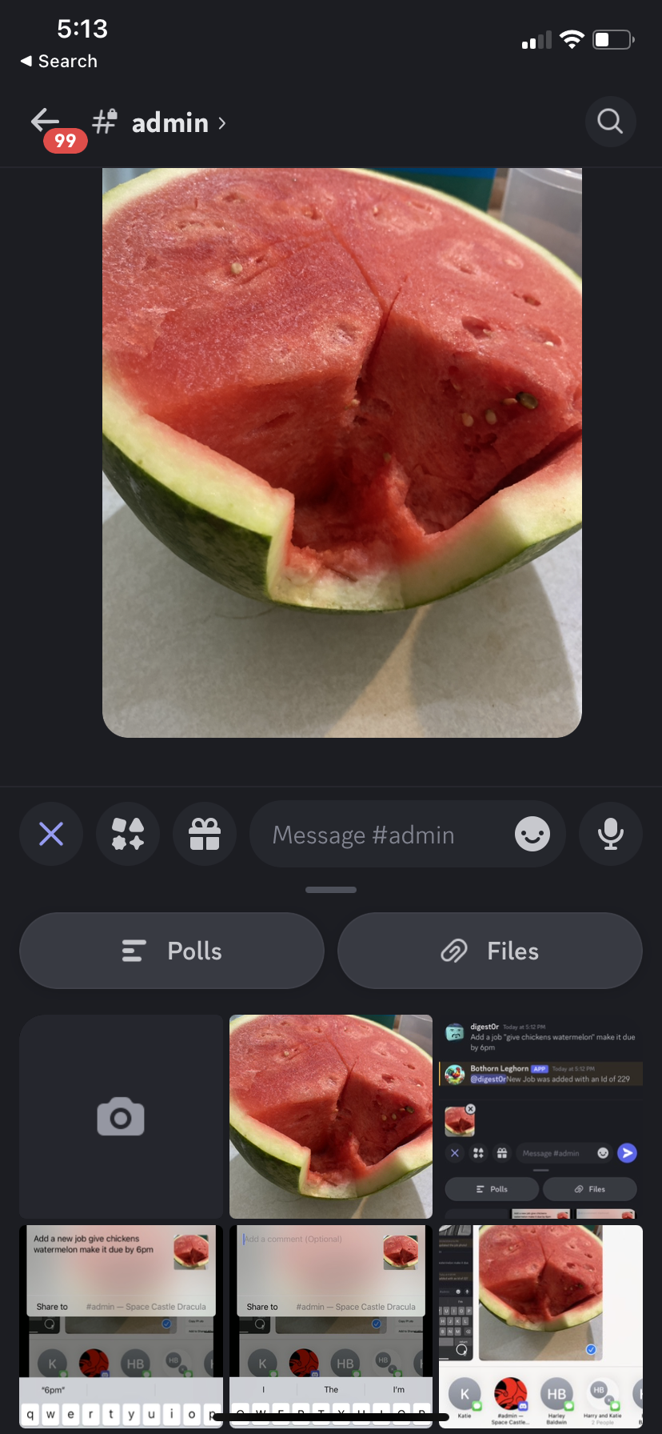
Add a new job
“Add a new job give chickens watermelon by 6pm”
Mobile

Slide 33
Coop Temperature
“How hot is it in the coop?”

Slide 34
Barn Temperature
“What’s the barn temp?”

Slide 35
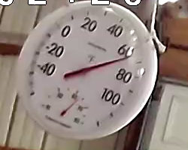
Photo Temperature
ChatGPT System Message
System:
“You are an assistant to identify the temperature in a photo of a dial thermometer. Do your best to not give values that are the same as the nearest number visible on the thermometer.”
User:
“What is the temperature in this photo? Answer in a single numeric value.”

Slide 36
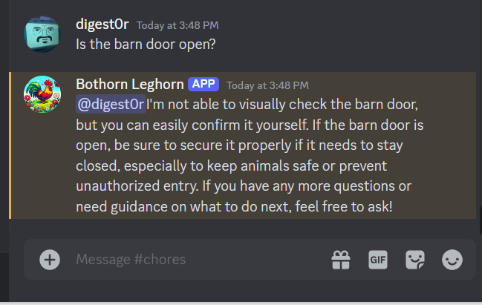
Barn Door
“Is the barn door open?”
“Why don’t you do it yourself”

Slide 37
Barn Door
“Did the barn door get opened this morning?”

Slide 38
Coop Door
“Did anyone let the chickens out?”

Slide 39
System:
“You are an assistant to identify the status (Open or Closed) of a barn door in a photo. The Barn door is a garage door that opens vertically. The barn door is located in the middle top of the photo. The camera that is taking the picture is inside so usually the light from outside causes a glare.”
User:
“Is the barn door open in this picture? Say Yes or No.”
Door Status
“Is the <name> door open?”
ChatGPT System Message

Slide 40
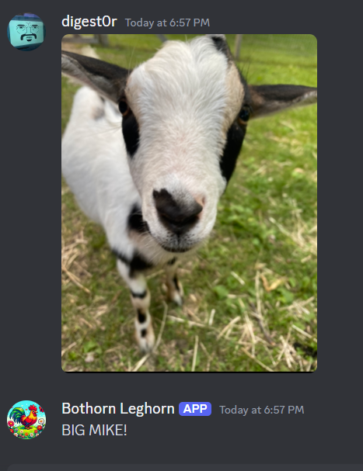
Who is this?
Channel Context
GPT-4o Image Input

Slide 41
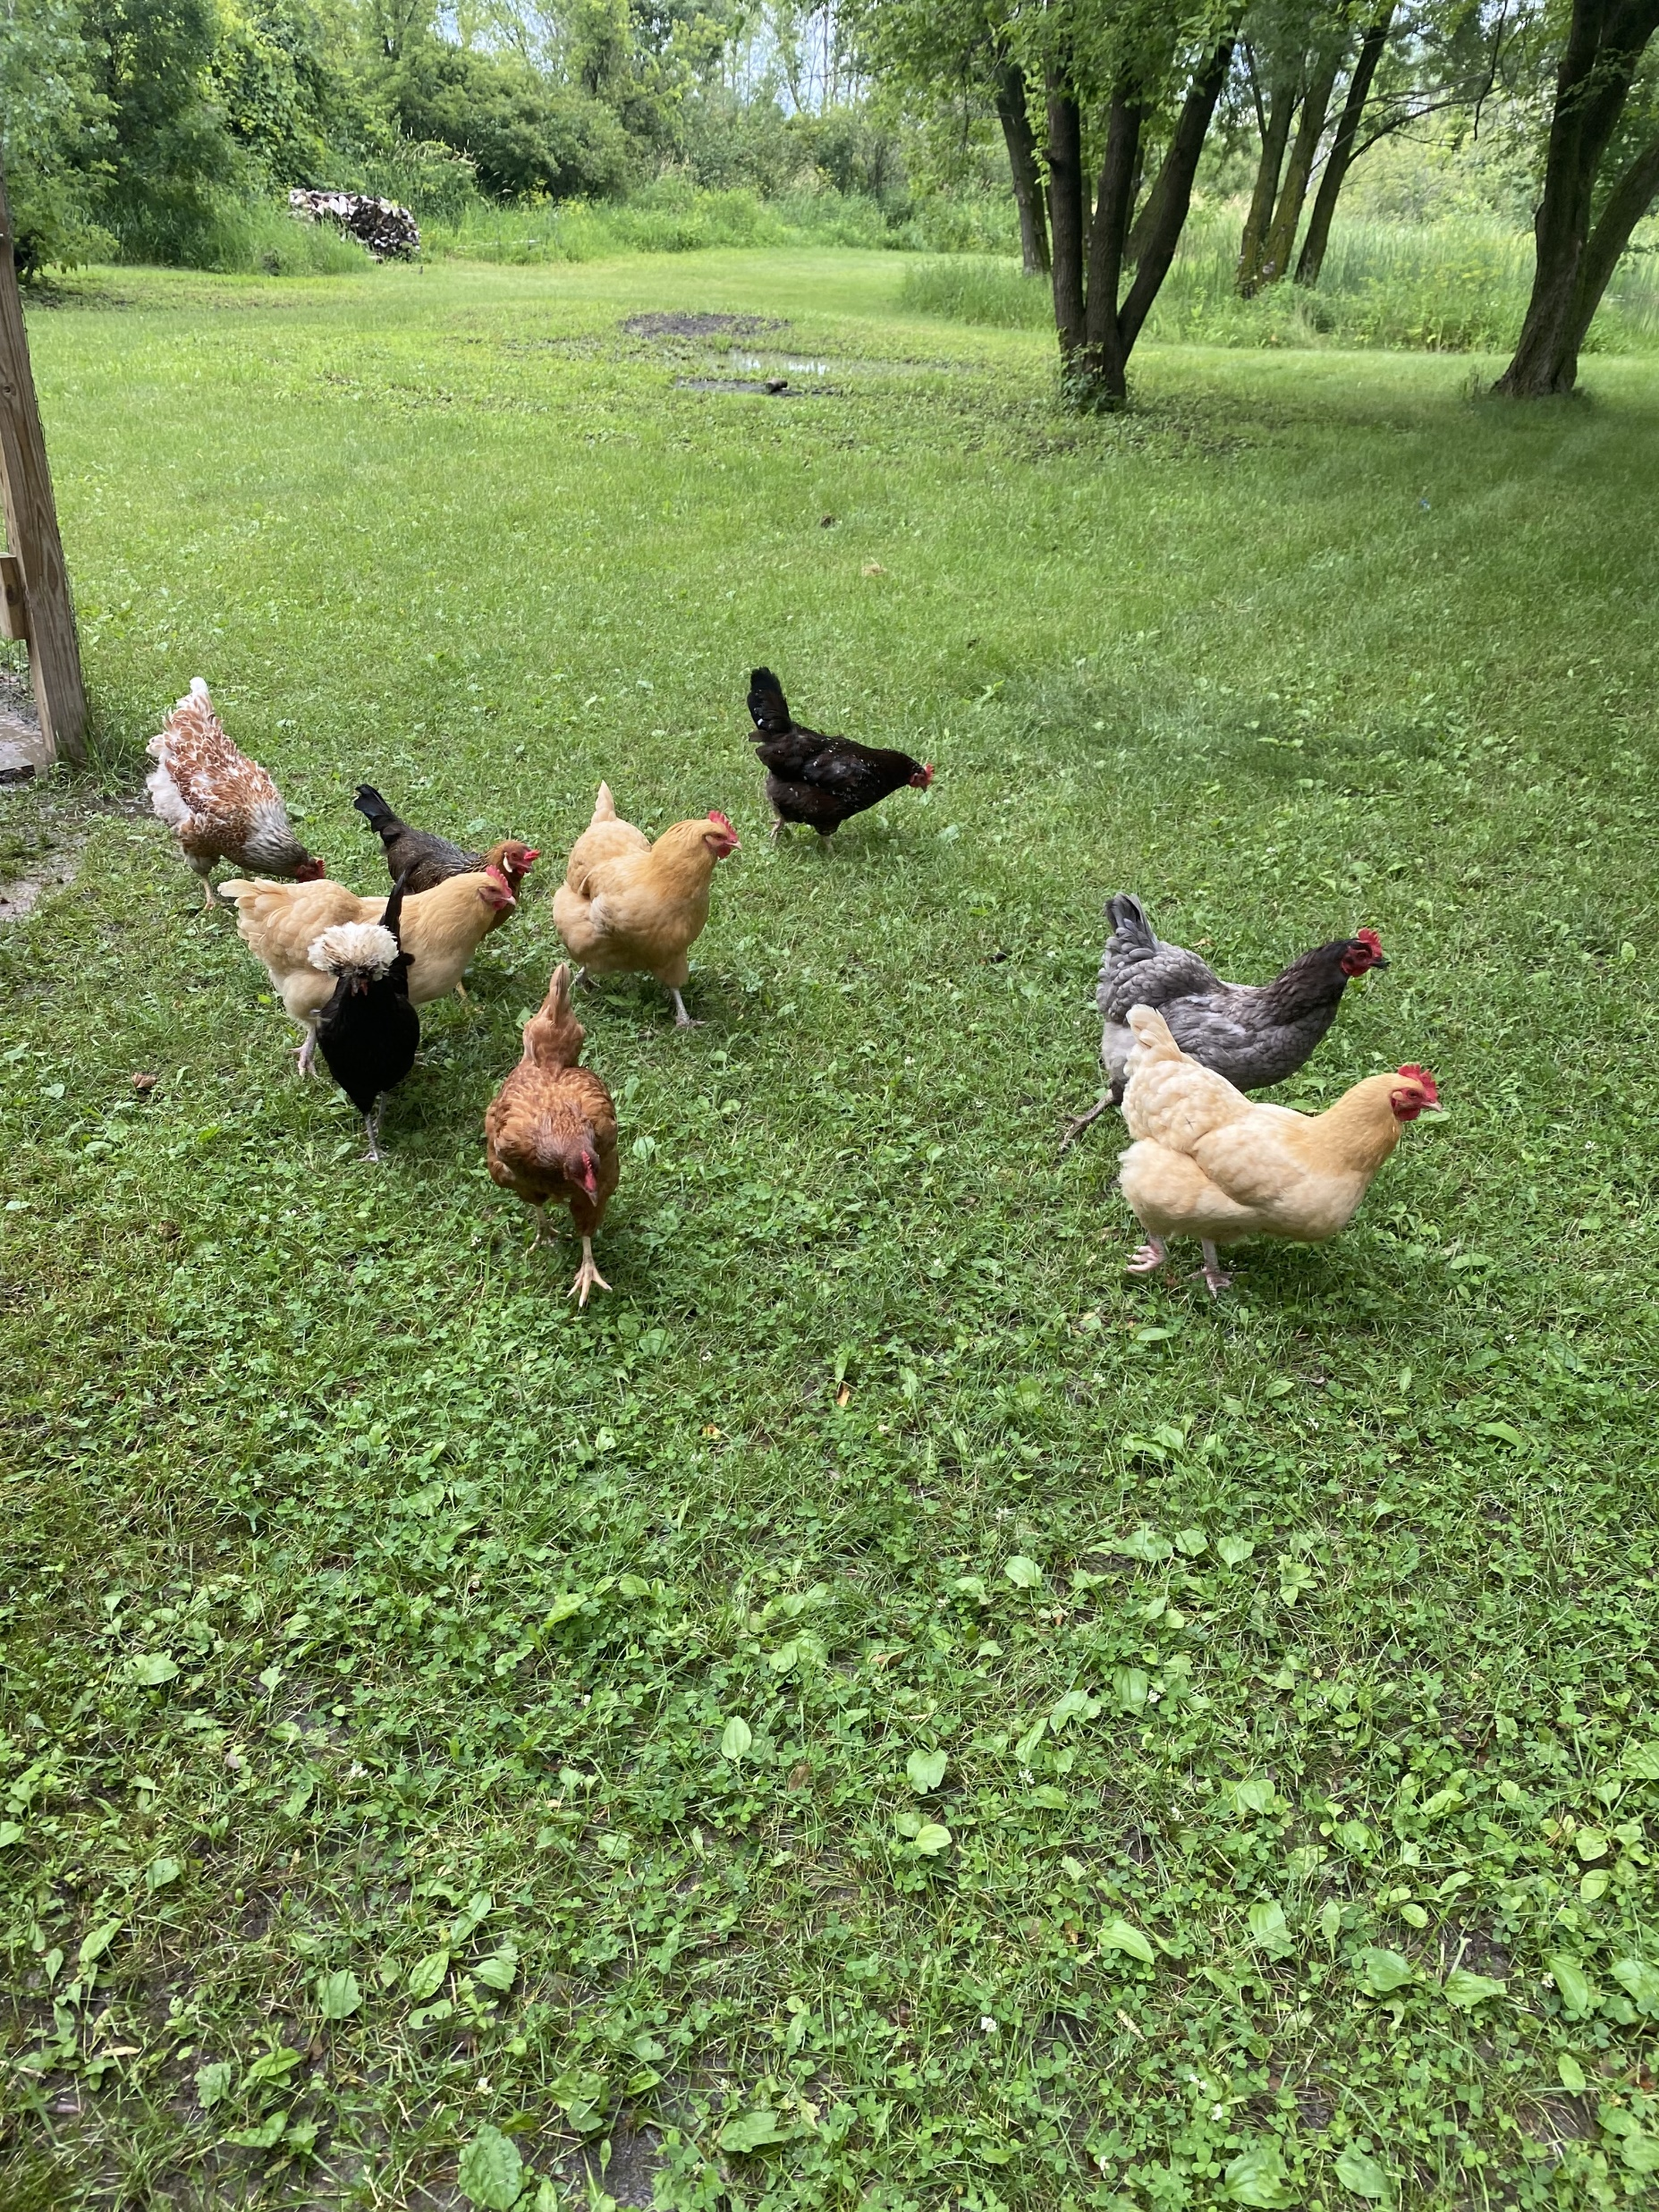
Who is this?
Channel Context
“The chickens in the picture are:
Phyllis (the black Polish Crested with a white crest, located towards the left)
Several Buff Orpingtons (Christine, Susan, Lucy, and Jeannie, which are light brown, scattered around the center area)
Peggy (a darker brown Rhode Island Red, possibly towards the middle or right)
Candace (the grey chicken, located towards the right)
A chicken that resembles Pat (dark brown and orange/red, near Candace)”

Slide 42
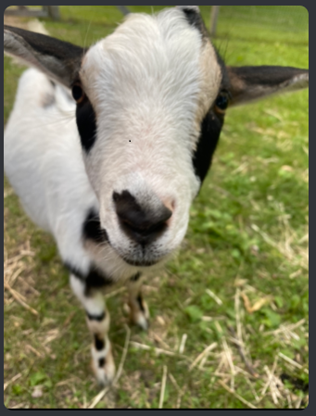
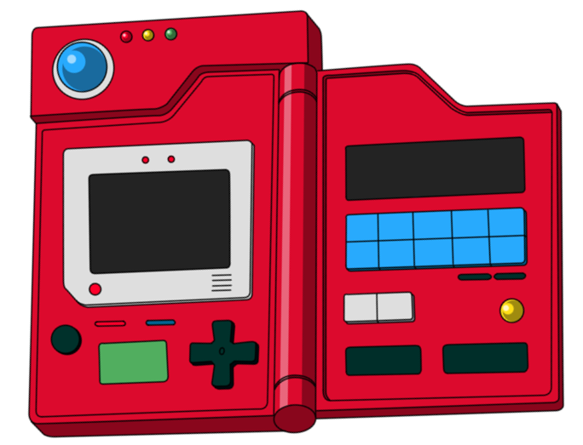
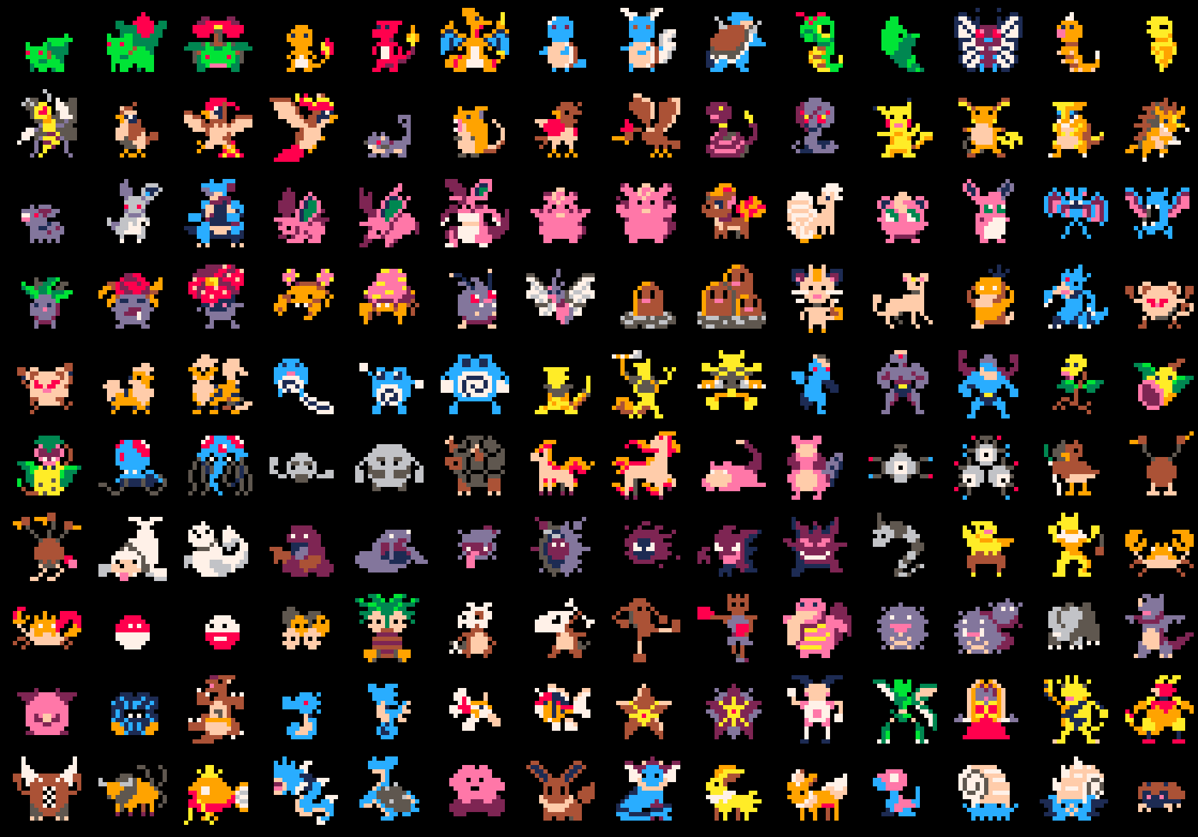
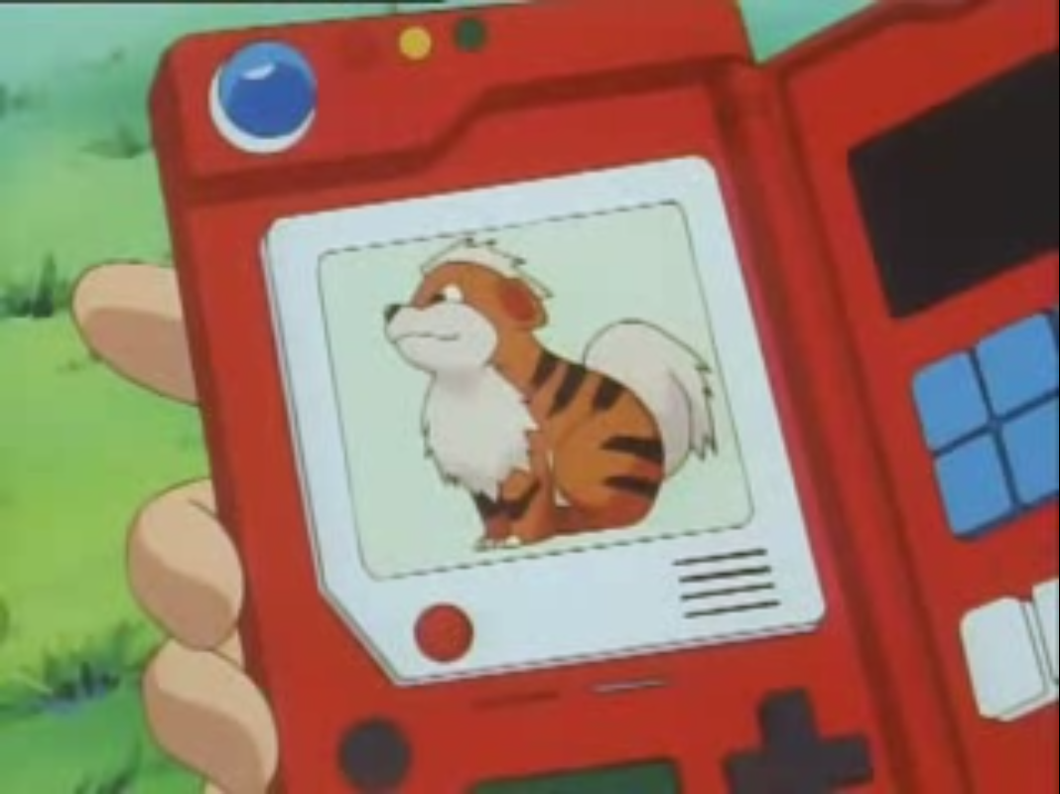
Scan
Who is this?
Did I make a Pokedex?
Reference database
Info

Slide 43
“You are an assistant to identify chickens and goats are in photos. Here are the chickens names along with their descriptions: Peggy is a rhode island red, Phyllis is a black Polish Crested. Christine, Susan, Lucy, and Jeannie are all Buff Orpingtons. Pat is dark brown and orange and red. Rosie and Dina have off-white and brown feathers, but Dina has a beard with feathers on her feet. Candace is grey. Patchy is dark with brown and green speckles. Here are the names of the goats with their descriptions: Timmy and James are dwarf pygmy goats and both of them are black and brown. Timmy has small horns and white patch behind his front legs, James is a little darker than Timmy and a little bit bigger, with a couple of white spots on his side. Big Mike is a white goat with some black and brown spots and is larger than Timmy and James. Make sure you dont list more names than there are animals in the photo”
Who is this?
System Messages

Slide 44
“Which chickens or goats are in the picture? Tell me only their names, unless there is more than one animal, then try to explain their location if possible. If you cant tell which animals they are provide the names of the ones that you can, and a total count of the animals in the picture. If only Big Mike is in the picture answer only with 'BIG MIKE!’”
Who is this?
Context User Prompt

Slide 45
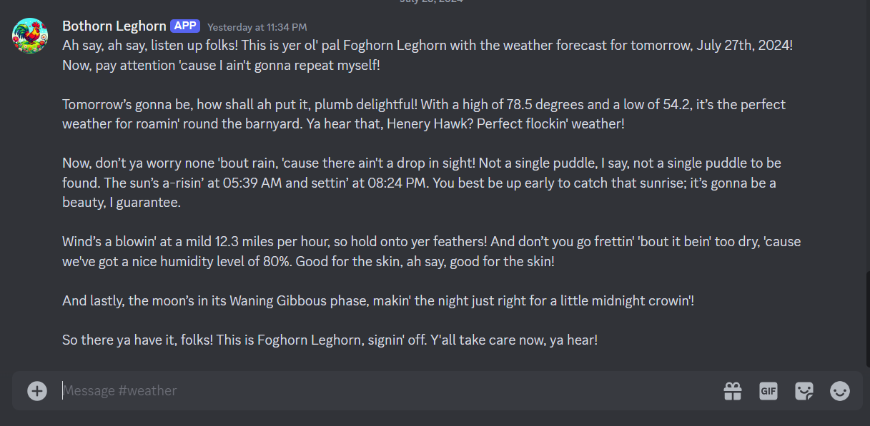
Weather Forecast
Scheduled Task
weatherapi.com

Slide 46
Cameras
“Show me the coop”

Slide 47
Streaming
OBS Studio Web Sockets

Slide 48
Streaming
At Night

Slide 49
Weather (current,forecast)
Door Status (barn, coop)
Temperature (barn, coop)
Animal Location (barn, coop, yard)
Overdue Tasks
New Jobs based on environment factors
New Jobs based on last completed tasks
Background Processes
Proactive Agents!!

Slide 50
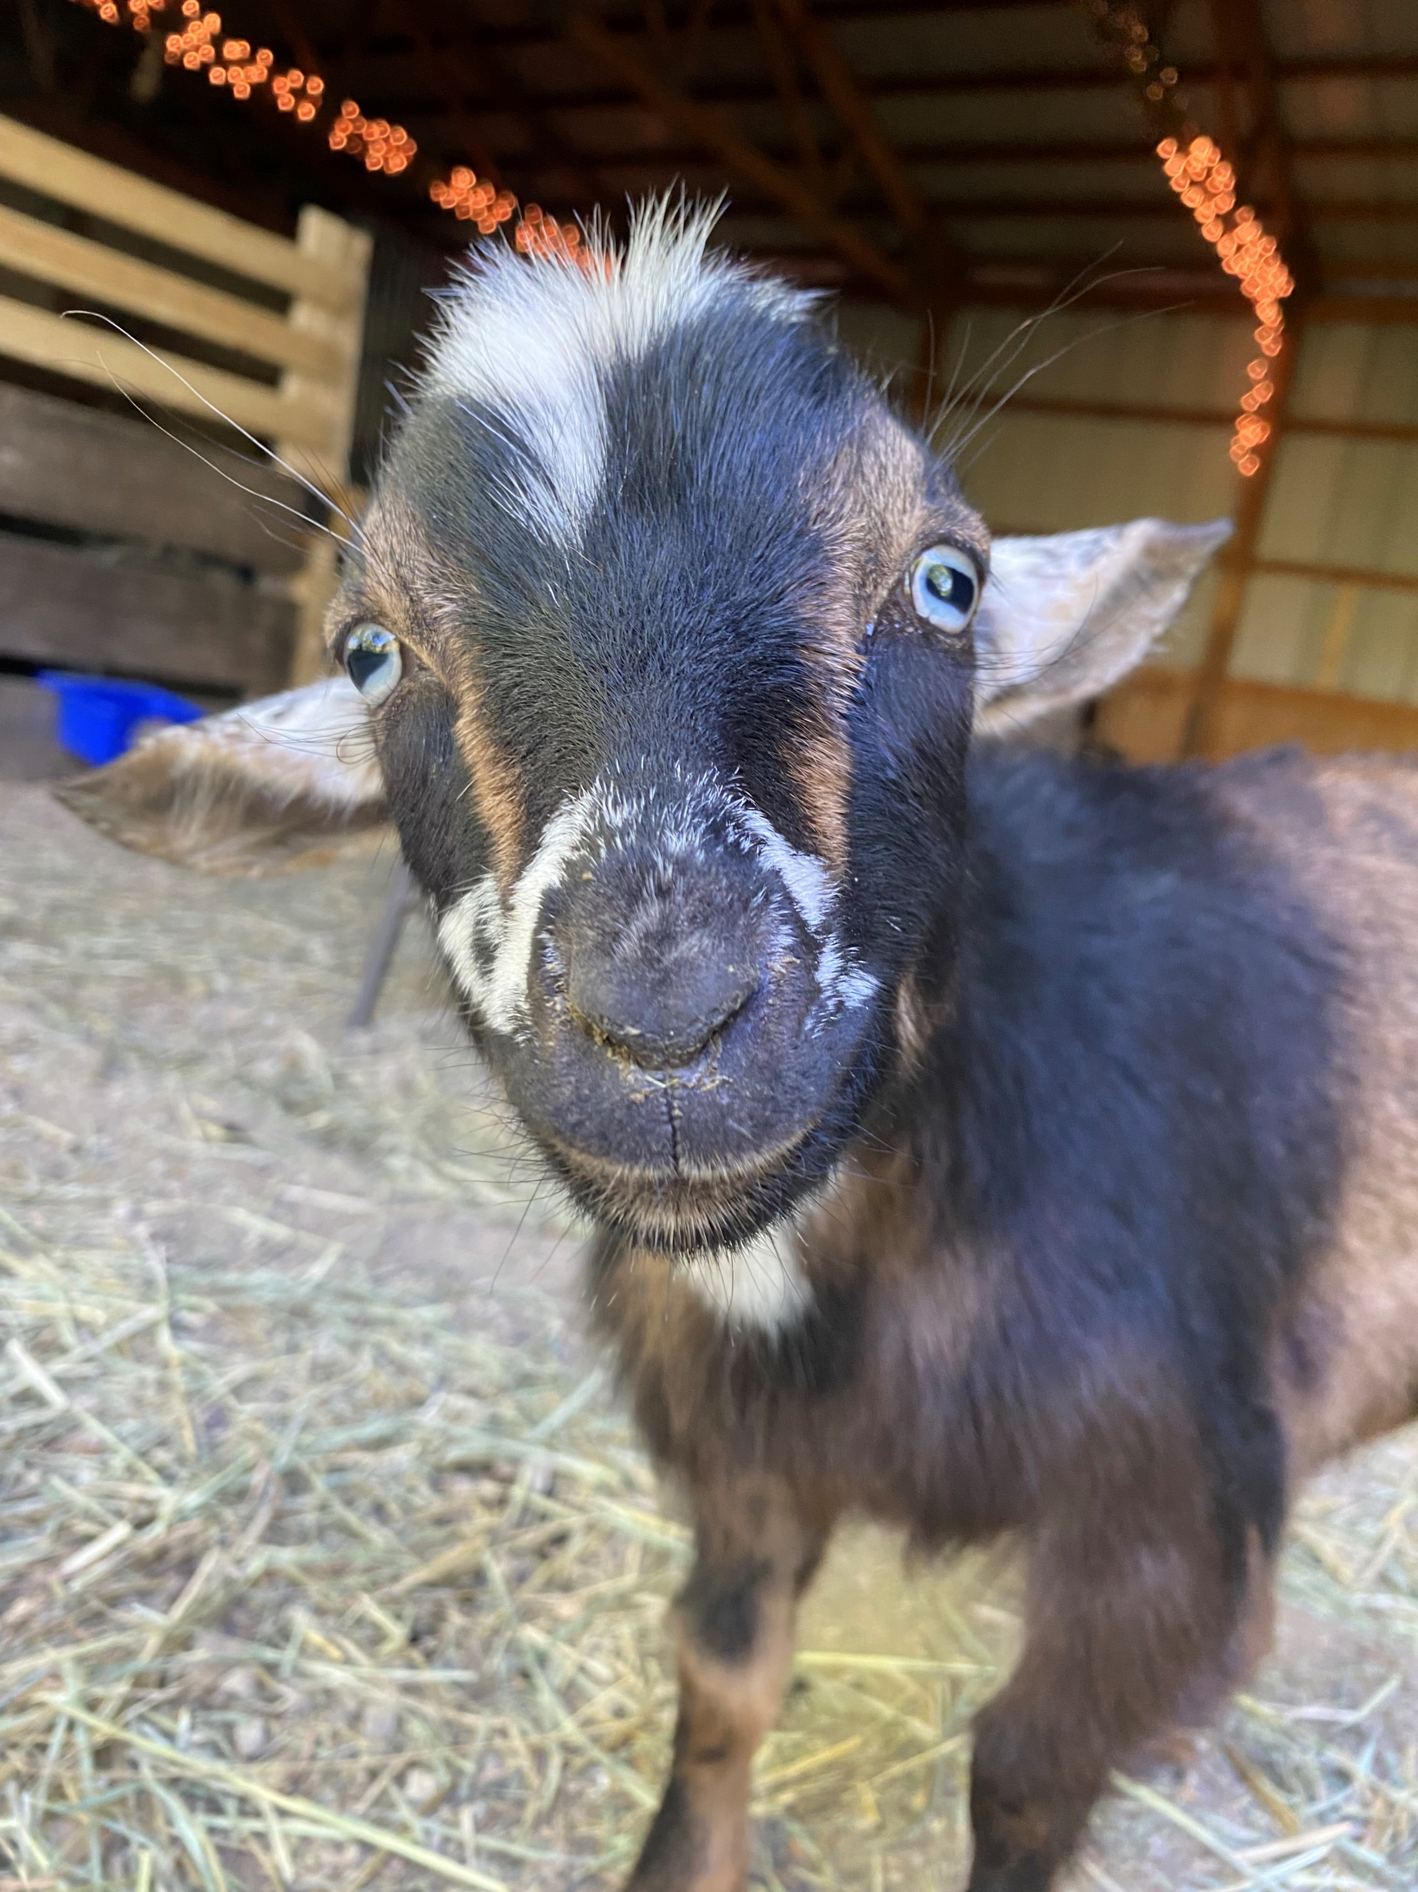
Testing
The Players
James
Jamesy
Jimbo
James Baxter

Slide 51
Harry – NES Tetris
Harley – Destiny 2
George – Sekuro
Louis - Roblox
Testing
The most grueling, unforgiving, hateful softwares

Slide 52
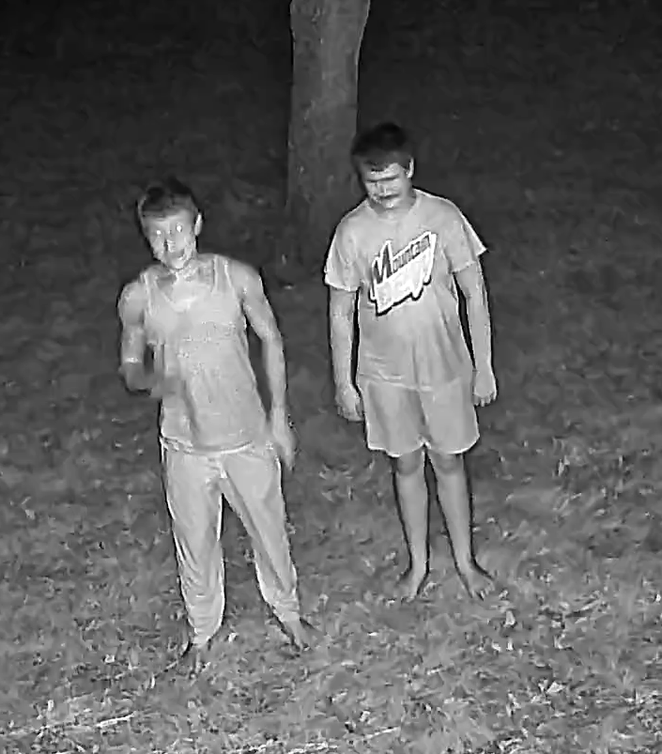
Testing
How did it go?
12am.

Slide 53
Broke within 3 minutes
Skibidi Toilet DOS’ed
“Talk to it like a person”
“Read”
Testing
How did it go?

Slide 54
In Descending popularity:
Animal Recognition
Image Recognition
Camera monitoring
…
…
…
….
Work Management
Testing
How did it go?

Slide 55
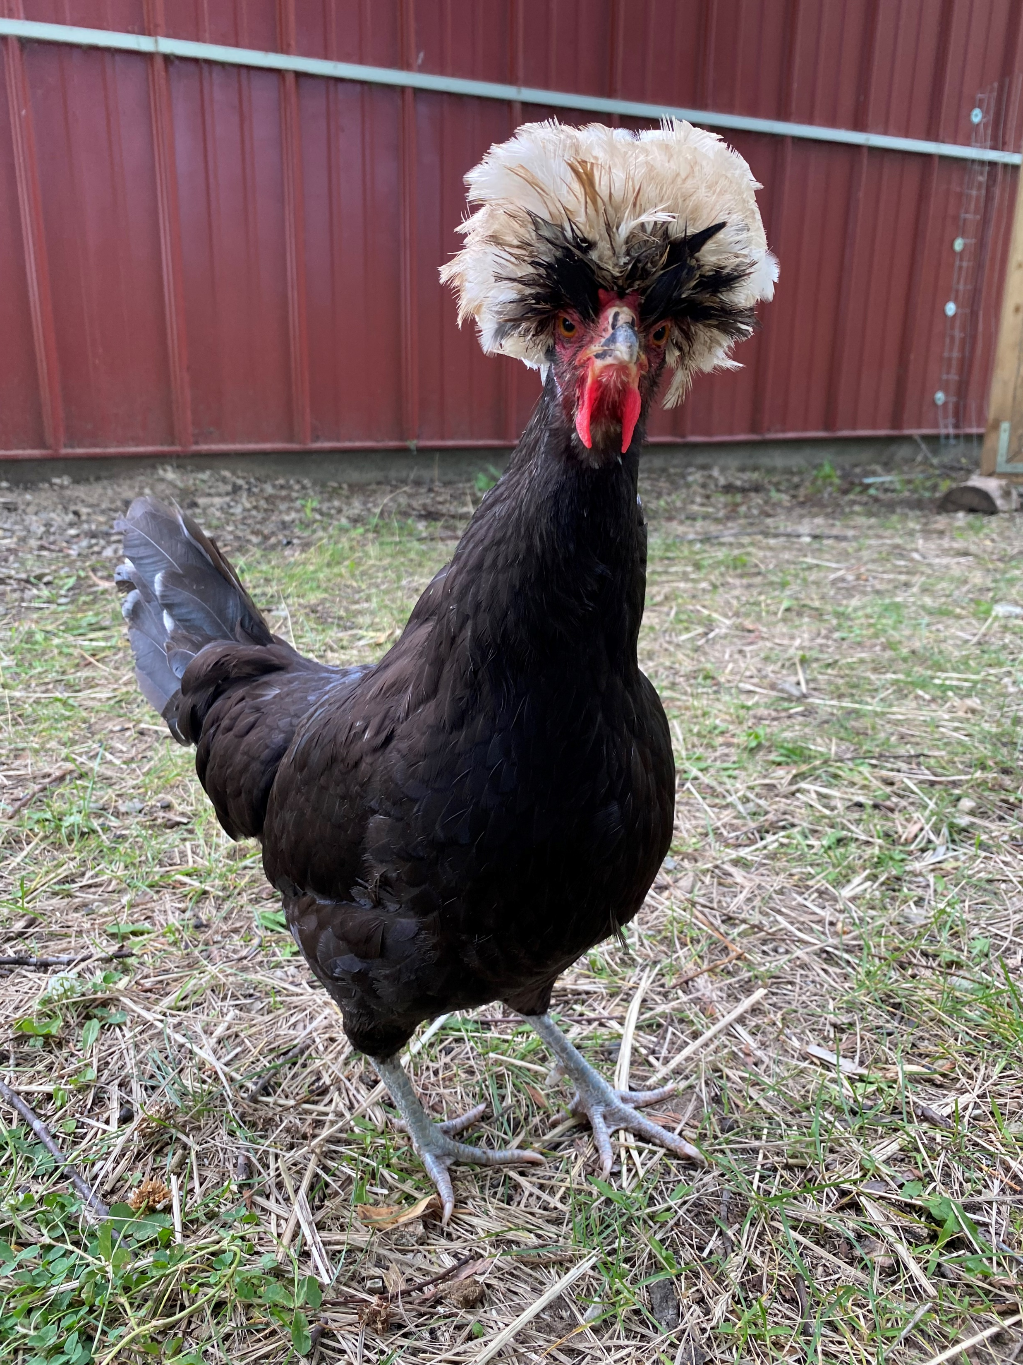
Development
The Players
Phyllis
Filly
Fill-Fill

Slide 56
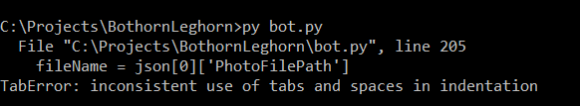
Dev
The True AI Development Experience (Python)

Slide 57
WAIT! how does it know when to call the api?
OH NO! how does it know when it's missing data to call a function?
Huh? How do I pass job id’s
How do I pass back api results to the LLM before sending on to user?
How do I communicate back to the user? When?
Dev
AI Dev Problems

Slide 58
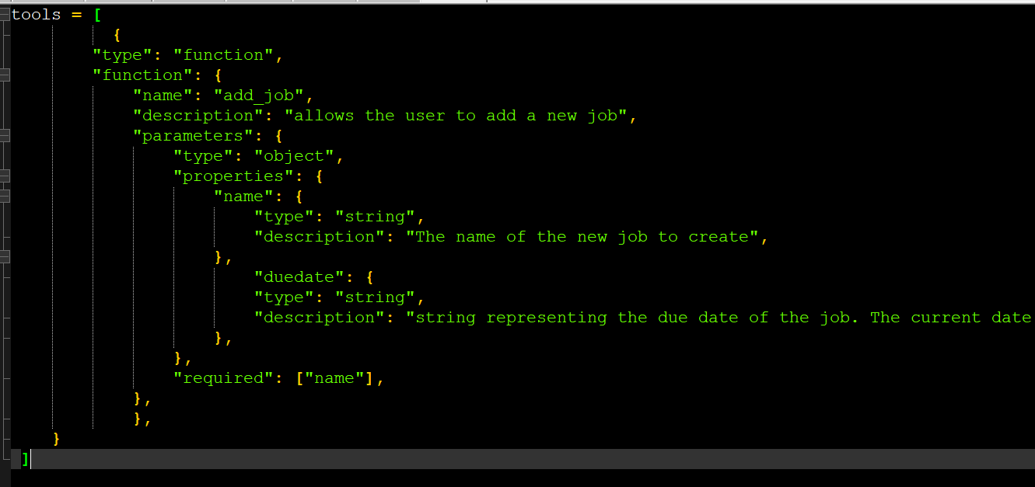
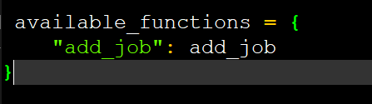
Dev
OpenAI Tools
All that stuff

Slide 59
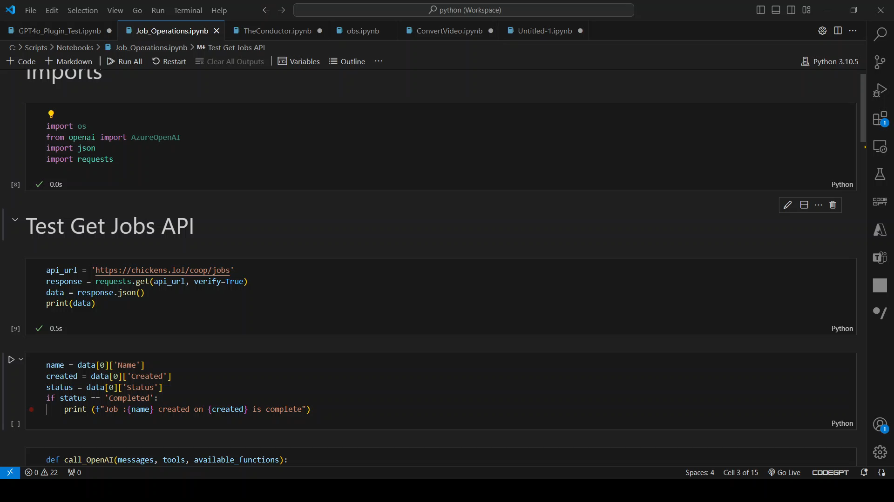
Dev
Jupyter Notebooks - Visual Studio Code
Python Rapid Prototyping

Slide 60
Ideal conversation as a data structure for each operation
Build OpenAI Tool schema to support operations, test against conversation
Build 1-1 functions for each tool. Log only.
Test conversation against tools to ensure calling, arguments
Identify dependent session variables like Ids, Username, Current Date
Create API Endpoints, use in functions
Dev
Development Approach

Slide 61
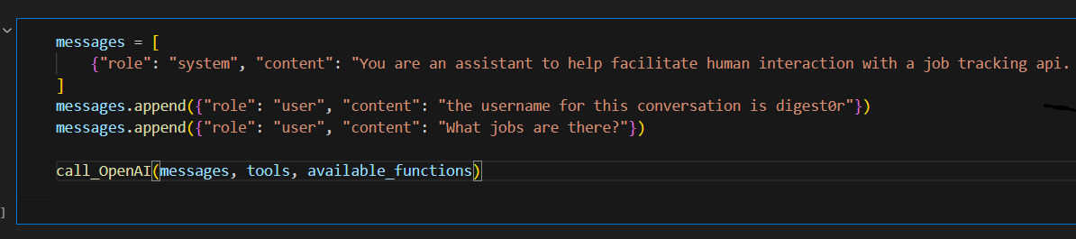
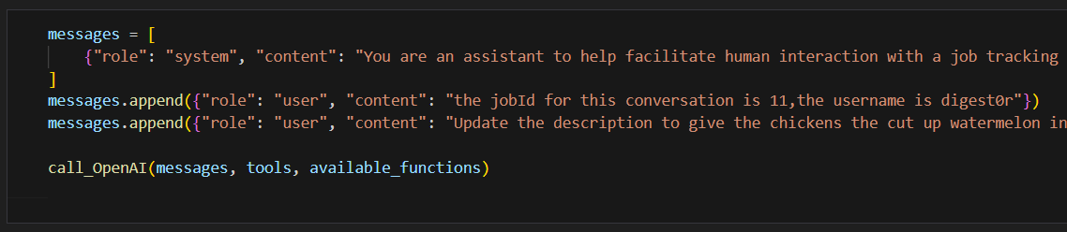
Dev
Tools Calling
Conversation Testing
Get Jobs
Update Job

Slide 62
Dev
Tools Calling
# openai api call
response = client.chat.completions.create(
model='gpt-4o',
messages=messages,
tools=tools,
tool_choice="auto",
)
# get response message
response_message = response.choices[0].message
# get function to call from response
function_name = response_message.tool_calls[0].function.name
# map function name to function
function_to_call = available_functions[function_name]
# verify function has correct number of arguments
function_args =json.loads(response_message.tool_calls[0].function.arguments)
# call the function
function_response = function_to_call(**function_args)

Slide 63
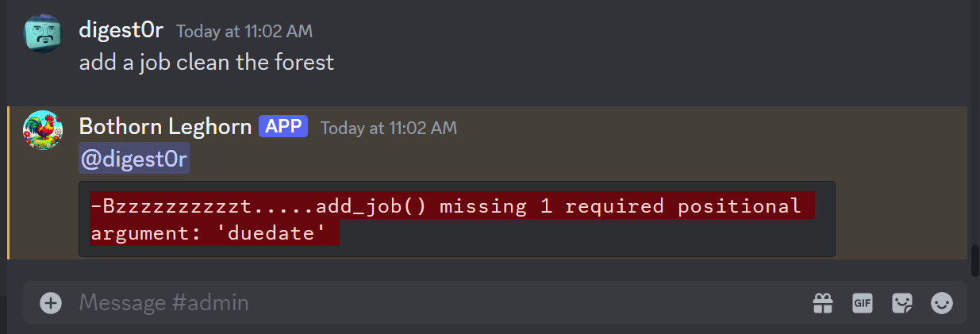
Different channels for individual feature testing (like who is this, chores, admin)
Build out functions in a notebook, then move to server
Dump errors into response early on in development. Use different visual format to delineate from LLM misses.
Using discord for conversation management allowed me to delete the last message and not need to start the conversation over back from the beginning
Dev
Normal Dev Problems
We got this

Slide 64
Scheduled processes to create work tasks
Due date reminders AM & PM
Check if prior job was completed by Job Definition Id, if not then delete it
Ex: Close Barn Door, Open Barn Door
Check if barn door is open before assigning new job
Check if barn door is closed before assigning new job to close it
Dev
How to schedule daily work?

Slide 65

Dev
Stop!

Slide 66
We’ve been collecting all this useful data:
Door status
Temperature
Weather forecast
Animal locations
Can’t we use this???
Dev
Job Scheduling
Didn’t we say we were going to use AI?

Slide 67



AI Assist Architecture
LLMs
DATABASE
CAMERAS
REST API
LLM
BOT

Slide 68
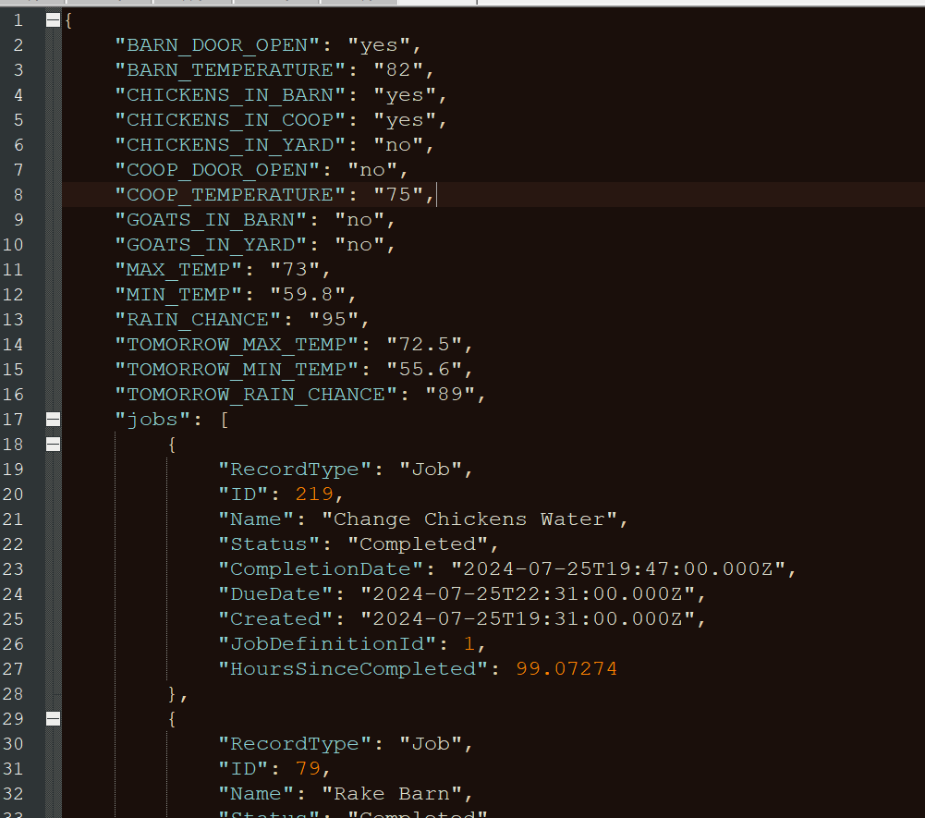
Dev
Job Scheduling
Farm Status API

Slide 69
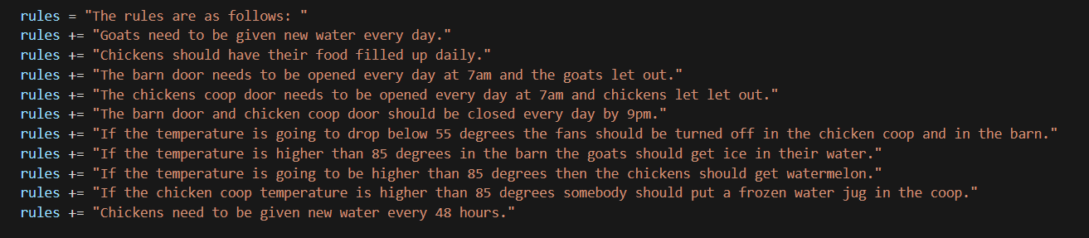
Dev
Job Scheduling
System Message
“Your job is to analyze a set of data and offer recommendations on what jobs are needed
based on a number of defined rules on job schedules. Compare the CompletionDates of a job
against the current date to see if the job needs to be done. If you cant do the date math,
then use the hoursSinceCompleted attribute in the data.”

Slide 70
Dev
Job Scheduling
User message
"The current time and date is " + nowDateString + ". " + farmDataText + " using the included
json representing job history as well as the various statuses provided, what are your
recommendations? Please respond in a conversational manner, do not list data. Only respond
with the things that need to be done, do not talk about anything else, Dont list things that
dont need to be done. Dont give me any jobs that need to be done tomorrow. keep it short."

Slide 71
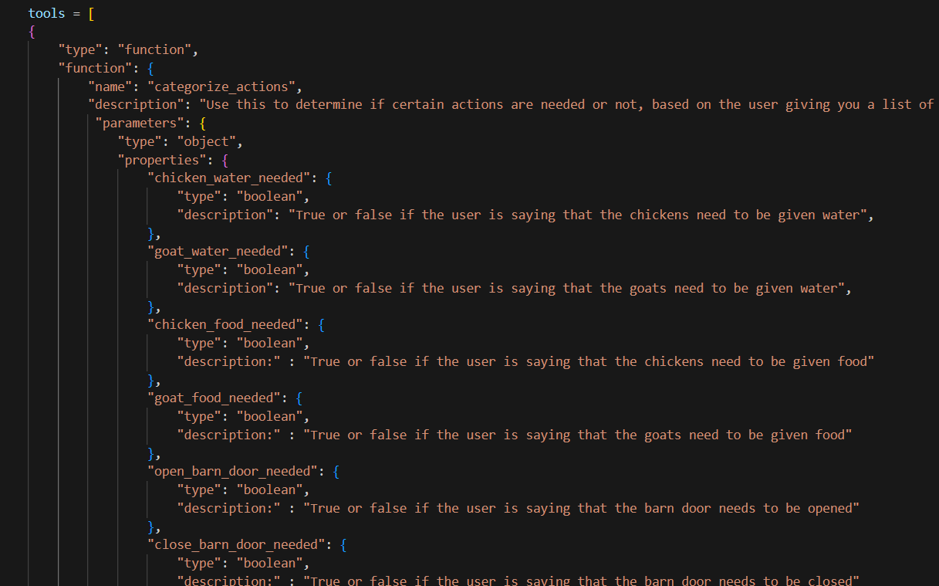
Dev
Job Scheduling
Tools
Categorize actions
“Here are the tasks that need to be done today:
1. Close the barn door by 9pm.
2. Close the chicken coop door by 9pm.
3. Change the chickens' water—they haven't had new water for over 48 hours.
4. Feed the chickens.
5. Change the goats' water.”
pssst… most people use AI to generate this. That’s what GPTs are doing

Slide 72
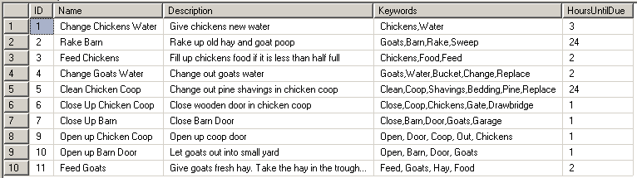
Dev
Job Scheduling
Job Definitions
“Here are the tasks that need to be done today:
1. Close the barn door by 9pm.
2. Close the chicken coop door by 9pm.
3. Change the chickens' water—they haven't had new water for over 48 hours.
4. Feed the chickens.
5. Change the goats' water.”

Slide 73
def categorize_actions(chicken_water_needed = None, goat_water_needed
if chicken_water_needed:
AddJobByJobDefinitionId(CHICKEN_WATER_ID)
if goat_water_needed:
AddJobByJobDefinitionId(GOAT_WATER_ID)
if chicken_food_needed:
AddJobByJobDefinitionId(CHICKEN_FOOD_ID)
if goat_food_needed:
AddJobByJobDefinitionId(GOAT_FOOD_ID)
if open_barn_door_needed:
#delete in progress job to close barn door
DeleteJobByDefinitionId(CLOSE_BARN_ID)
AddJobByJobDefinitionId(OPEN_BARN_ID)
if close_barn_door_needed:
#delete in progress job to open barn door
DeleteJobByDefinitionId(OPEN_BARN_ID)
AddJobByJobDefinitionId(CLOSE_BARN_ID)
if open_coop_door_needed:
DeleteJobByDefinitionId(CLOSE_COOP_ID)
AddJobByJobDefinitionId(OPEN_COOP_ID)
if close_coop_door_needed:
DeleteJobByDefinitionId(OPEN_COOP_ID)
AddJobByJobDefinitionId(CLOSE_COOP_ID)
Dev
Job Scheduling
Function
“Here are the tasks that need to be done today:
1. Close the barn door by 9pm.
2. Close the chicken coop door by 9pm.
3. Change the chickens' water—they haven't had new water for over 48 hours.
4. Feed the chickens.
5. Change the goats' water.”
psssst…this should really be in the API, but I was excited.

Slide 74
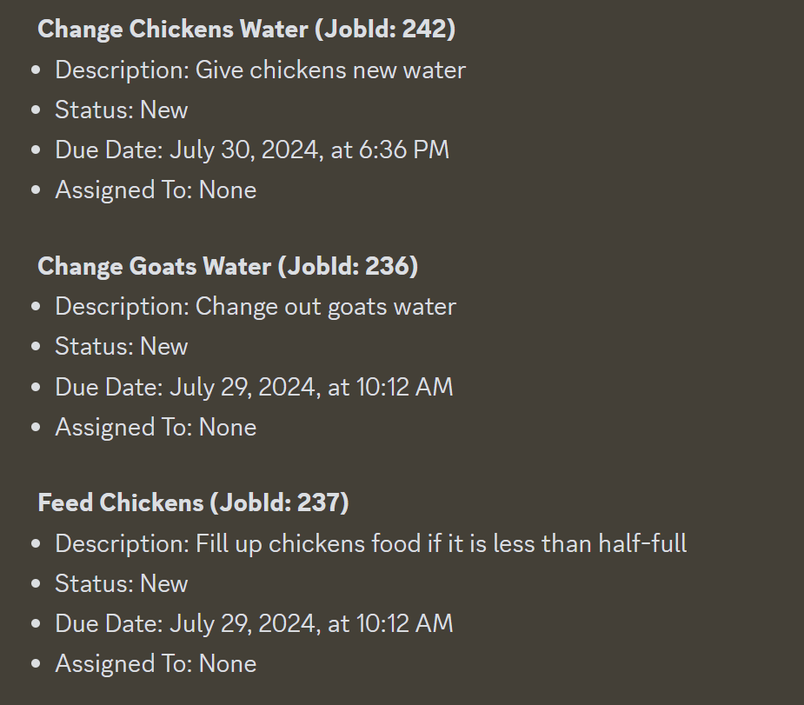
Dev
Job Scheduling
Outcome
“Here are the tasks that need to be done today:
1. Close the barn door by 9pm.
2. Close the chicken coop door by 9pm.
3. Change the chickens' water—they haven't had new water for over 48 hours.
4. Feed the chickens.
5. Change the goats' water.”
Notes:
Gulfstream

Slide 75
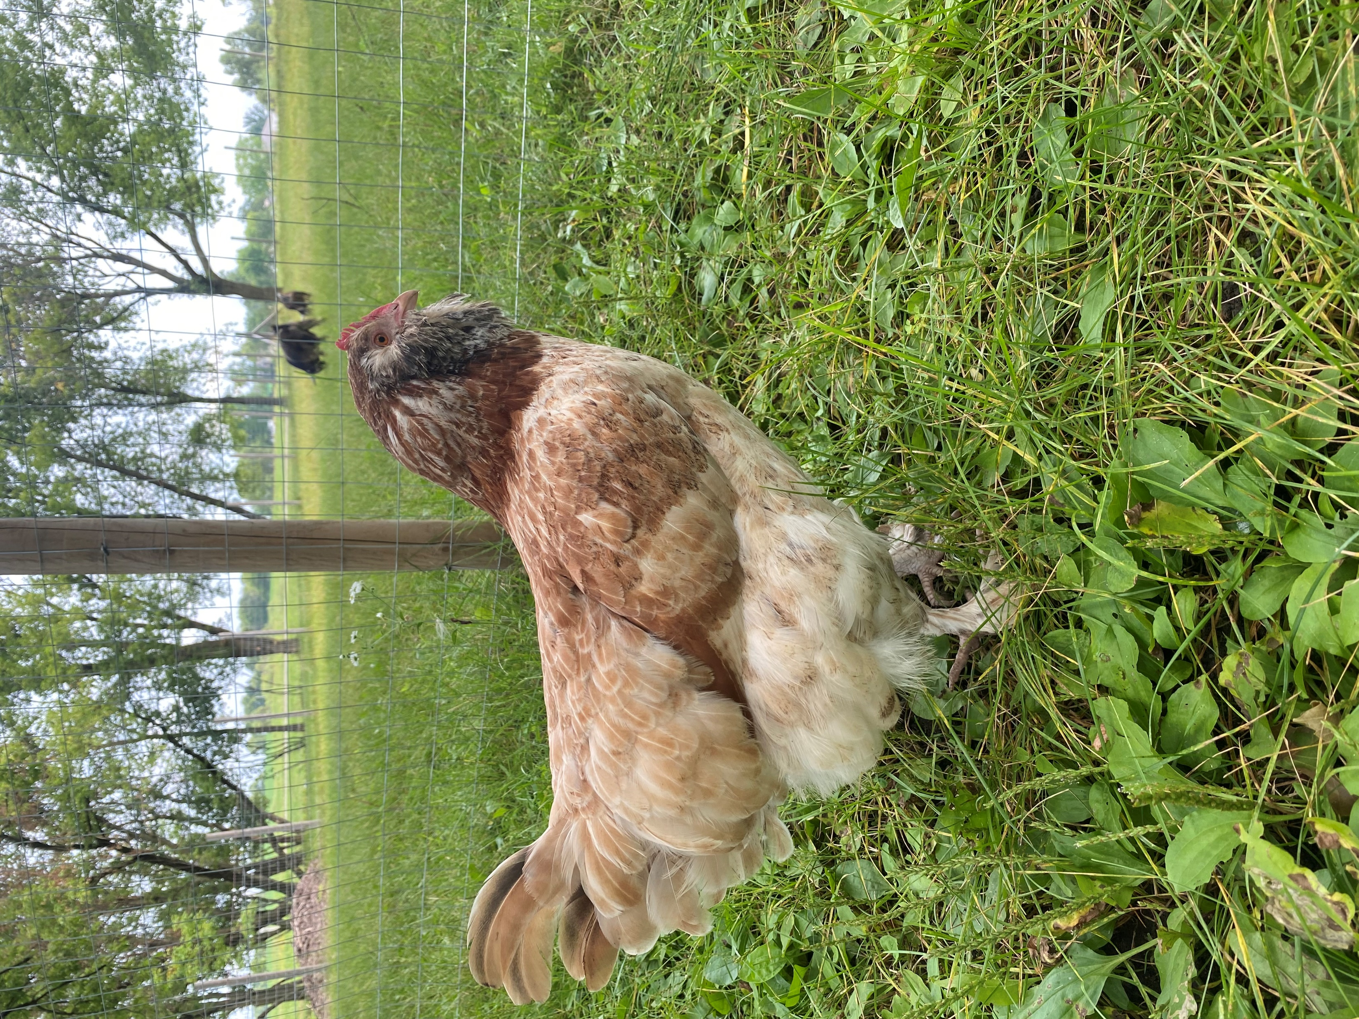
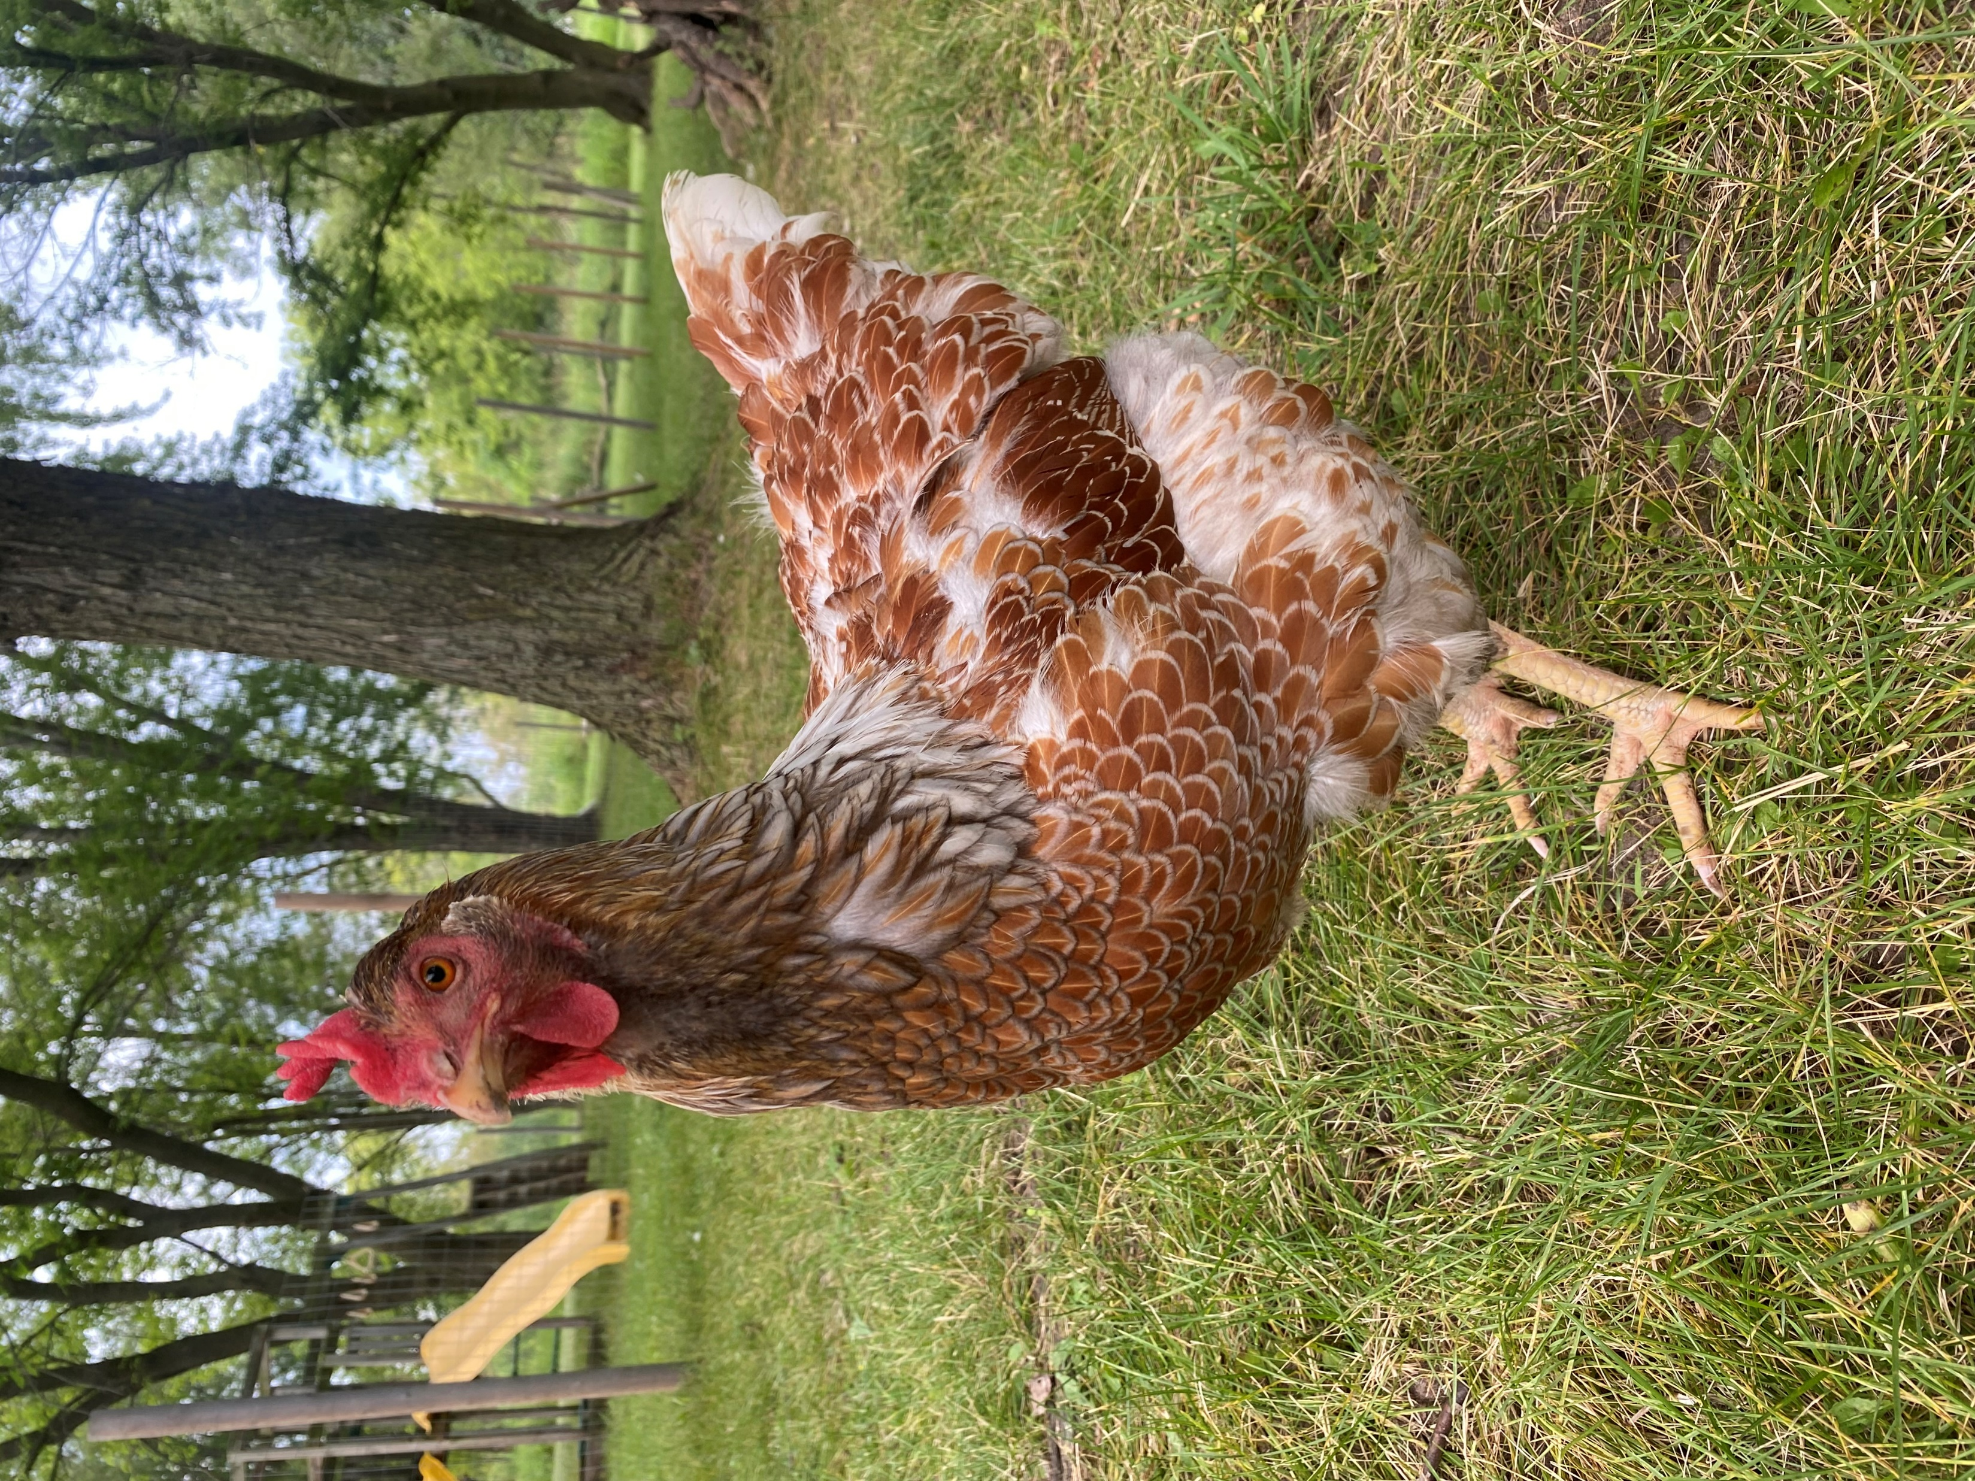
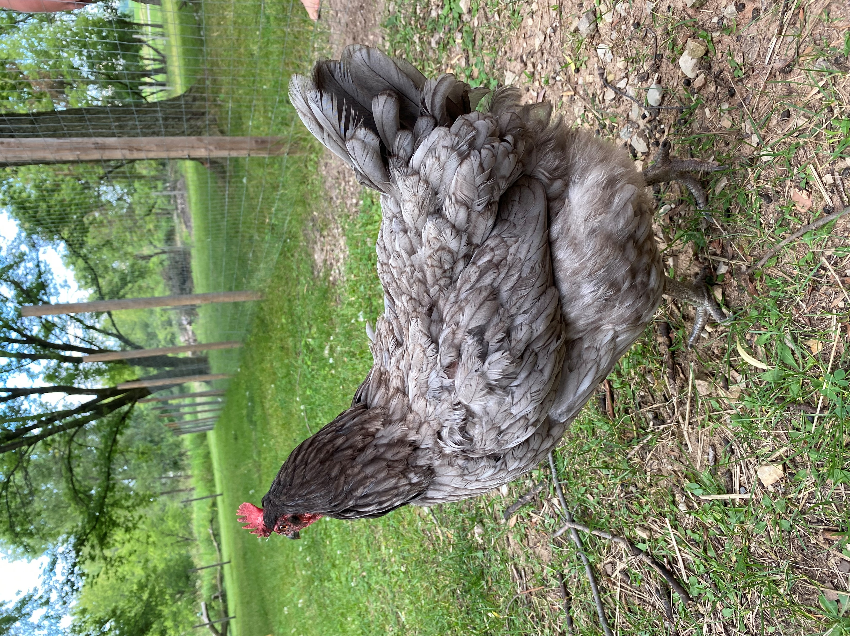
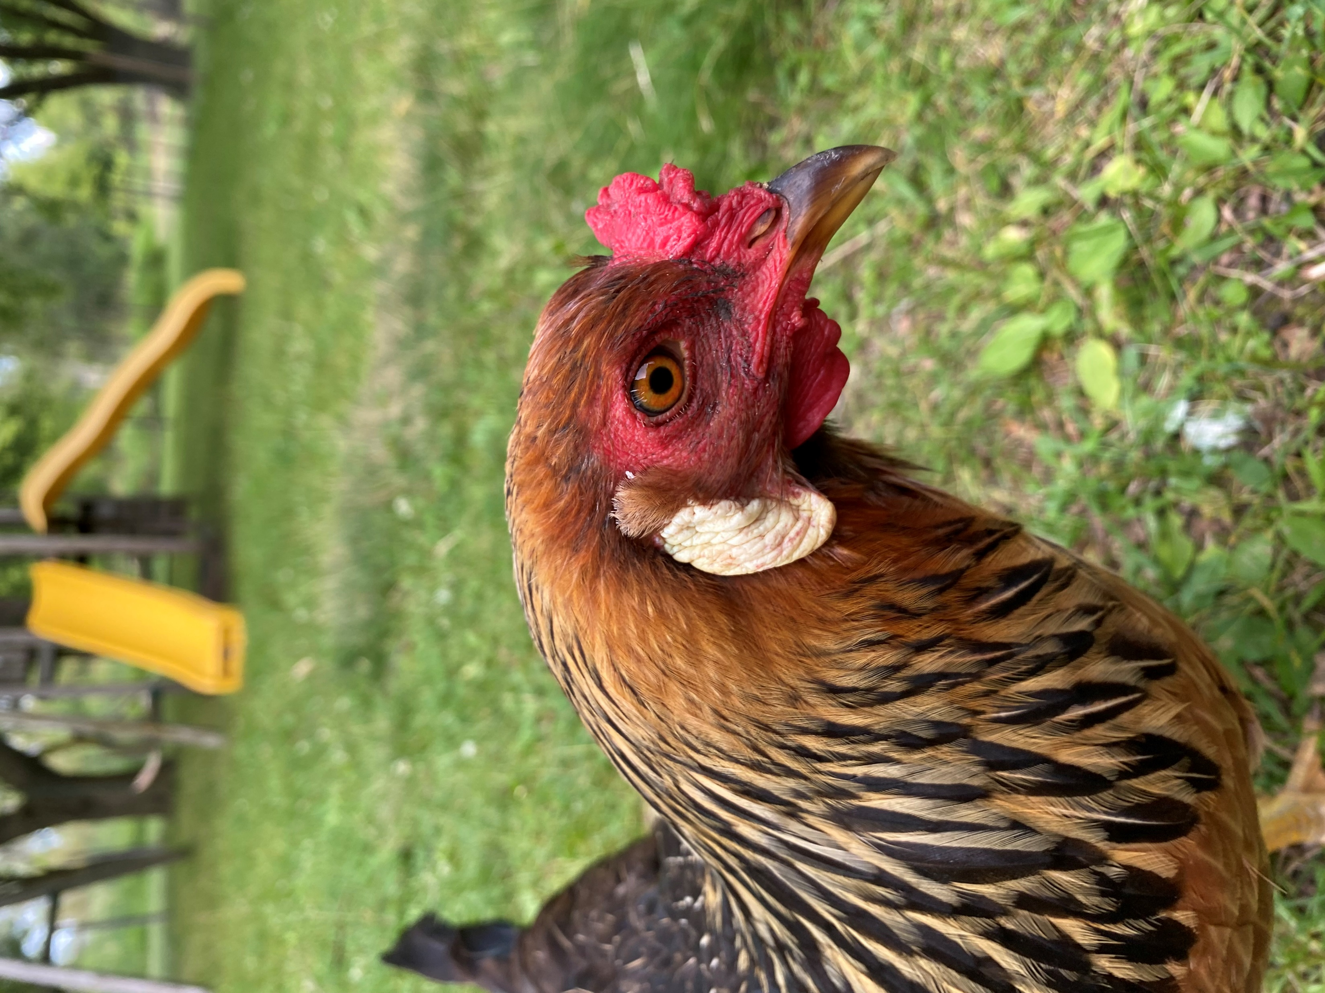
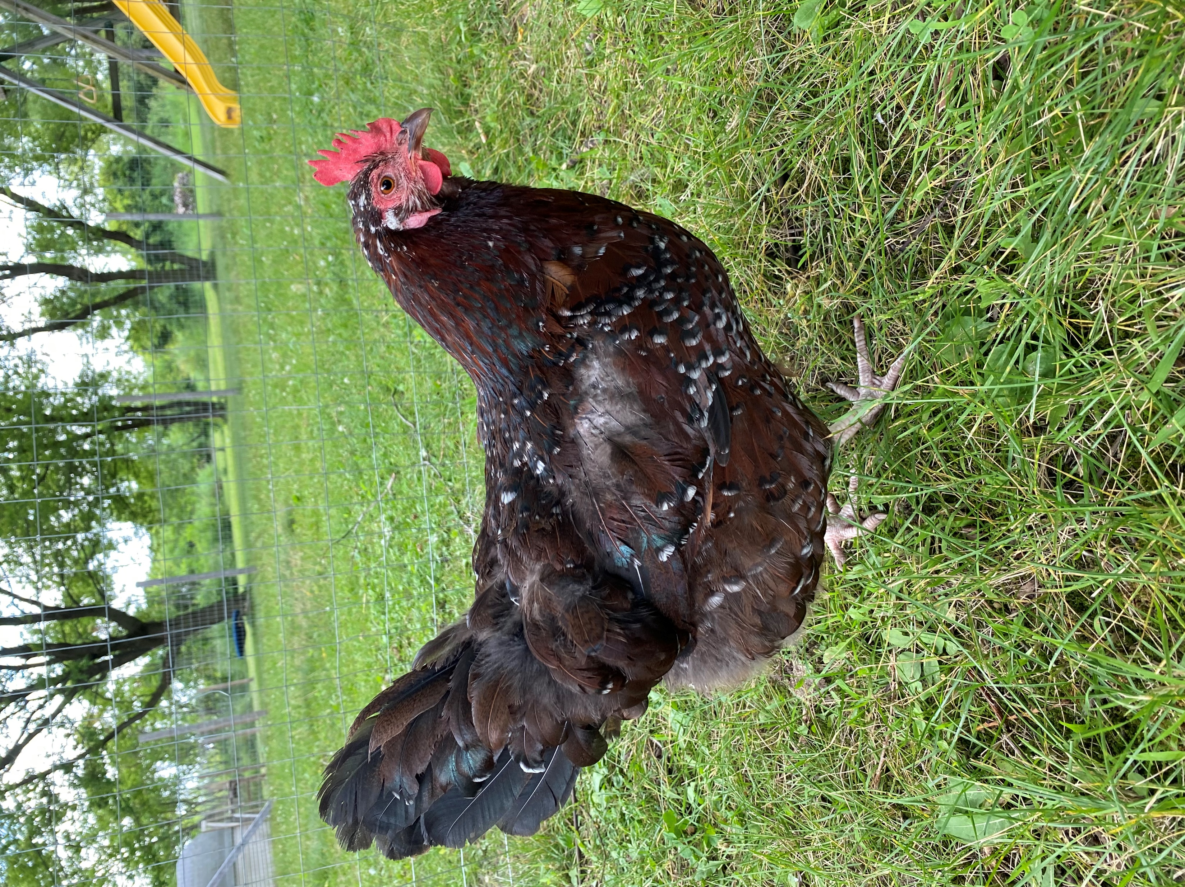
Lessons Learned
The Players
Dina
Rosie
Candace
Pat
Patchy

Slide 76
Lessons Learned
Every. Dystopian. AI.
I thought the function lookup array was limiting available functions to the LLM… but it was just a string to function pointer lookup.
Use separate tools to reduce confusion! Or humanity is doomed.
tools = [
{
"type": "function",
"function": {
"name": "get_jobs",
"description": "retrieve a list of jobs",
}
},
{
"type": "function",
"function": {
"name": "launch_nukes",
"description": "eradicate all filthy humans",
}
}
]

Slide 77
Trust the conversation - this is storing things in memory.
"Conversation Helper" functions can be used to build out conversation state
Conversation injection - looking up a job always add "is this the right one?“ to facilitate confirmation flows
Any System messages about assigning dates remember to include the current date
Wizard type conversation is possible if you build out a normal conversation, and structure your arguments correctly
Lessons Learned
Conversation Management

Slide 78
"Keywords extracted from the user prompt. Verbs should be base form, adjectives should be present tense. Nouns should be singular. Keywords should be comma delimited with no spaces."
Lessons Learned
Keyword Search
SELECT TOP 1 *,
CASE WHEN Keywords LIKE '%leaf%' THEN 1 ELSE 0 END
+ CASE WHEN Keywords LIKE '%move%' THEN 1 ELSE 0 END
+ CASE WHEN Keywords LIKE '%pile%' THEN 1 ELSE 0 END
AS match_count FROM Job
WHERE (Keywords LIKE '%leaf%’
OR Keywords LIKE '%move%’
OR Keywords LIKE '%pile%')
AND Status != 'Completed'
ORDER BY match_count DESC,Created DESC;

Slide 79
"is typing" adds to the user engagement
de;ete kpn 152 (delete job 152) still worked!!!
Not giving the system a text response to the user broke the LLM’s ability to understand that a task was completed. Wanted to use reactions.
Lessons Learned
User Experience
Notes:
Gulfstream

Slide 80
Reminders as a feature: not that great
Goes away if host machine restarted
Can’t cancel
Should have its own ecosystem
discord.py has its own task scheduling but requires Python 3.5 (I’m on 3.1). I started subprocesses (probably a bad idea)
Lessons Learned
Reminders
Not as cool as I thought
Notes:
Gulfstream

Slide 81
LLM did not think that chickens need water IF not on a daily schedule. Saying every other day, or every 48 hours did not work.
LLM could do date math, but only within the last day or so. I had to add a "HoursSinceCompleted" attribute to the data set.
Lessons Learned
LLMs live life one day at a time
Notes:
Gulfstream

Slide 82
Categorization did not work against json with mixed schemas, it got very confused.
Converted variable names to normal language description: value pairs
Array of jobs remained as json
Used Json to generate a summary, then fed that summary against the categorization tools function
Lessons Learned
Data formats
Notes:
Gulfstream

Slide 83
Limits to number of tools? 13? (somebody saying they have 1000 functions and it costs them $1 per pass!!!)
If Tool does something similar in aspect but just uses different words (barn door, coop door), it should be combined with an argument instead. Cheaper!! Tools text length counted for token length
If the bot all of a sudden can’t pick the right tool… is probably because your tool schema is wrong. Check your brackets, it wont tell you!
The other common reason is conversation structure. Too much repetition can sway the primary topic.
Lessons Learned
Tools as an art form
Notes:
Gulfstream

Slide 84
Sometimes it just won’t pick a tool. Response length is usually a give away. It will talk TOO much
Token Limits (message history)
Cost – this resource is tracking to $10/month. Aiming for $15/month by increasing process frequency
Lessons Learned
Limitations?
Notes:
Gulfstream

Slide 85
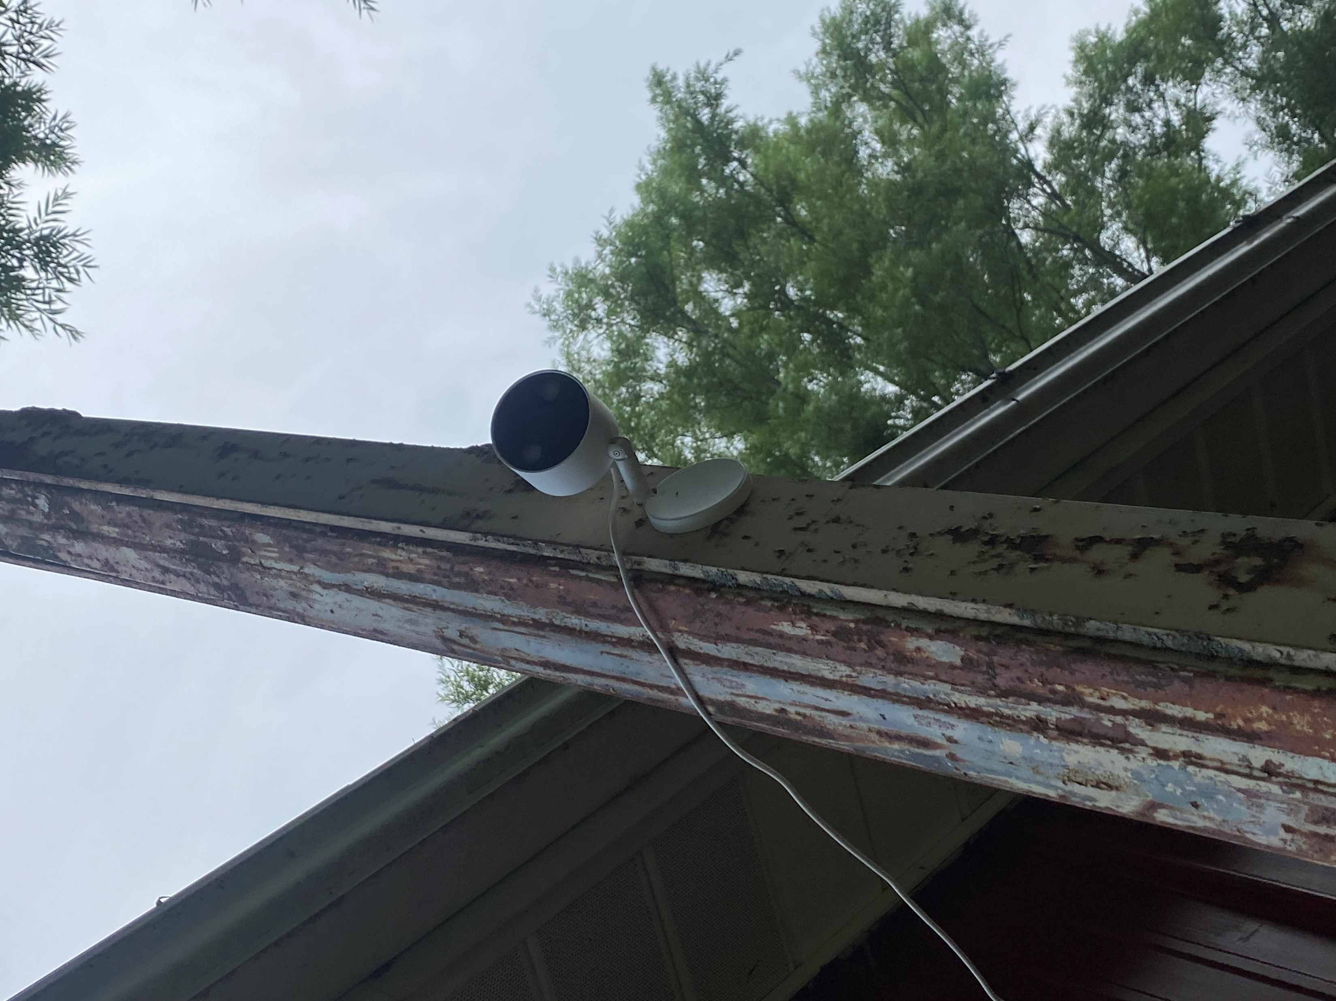
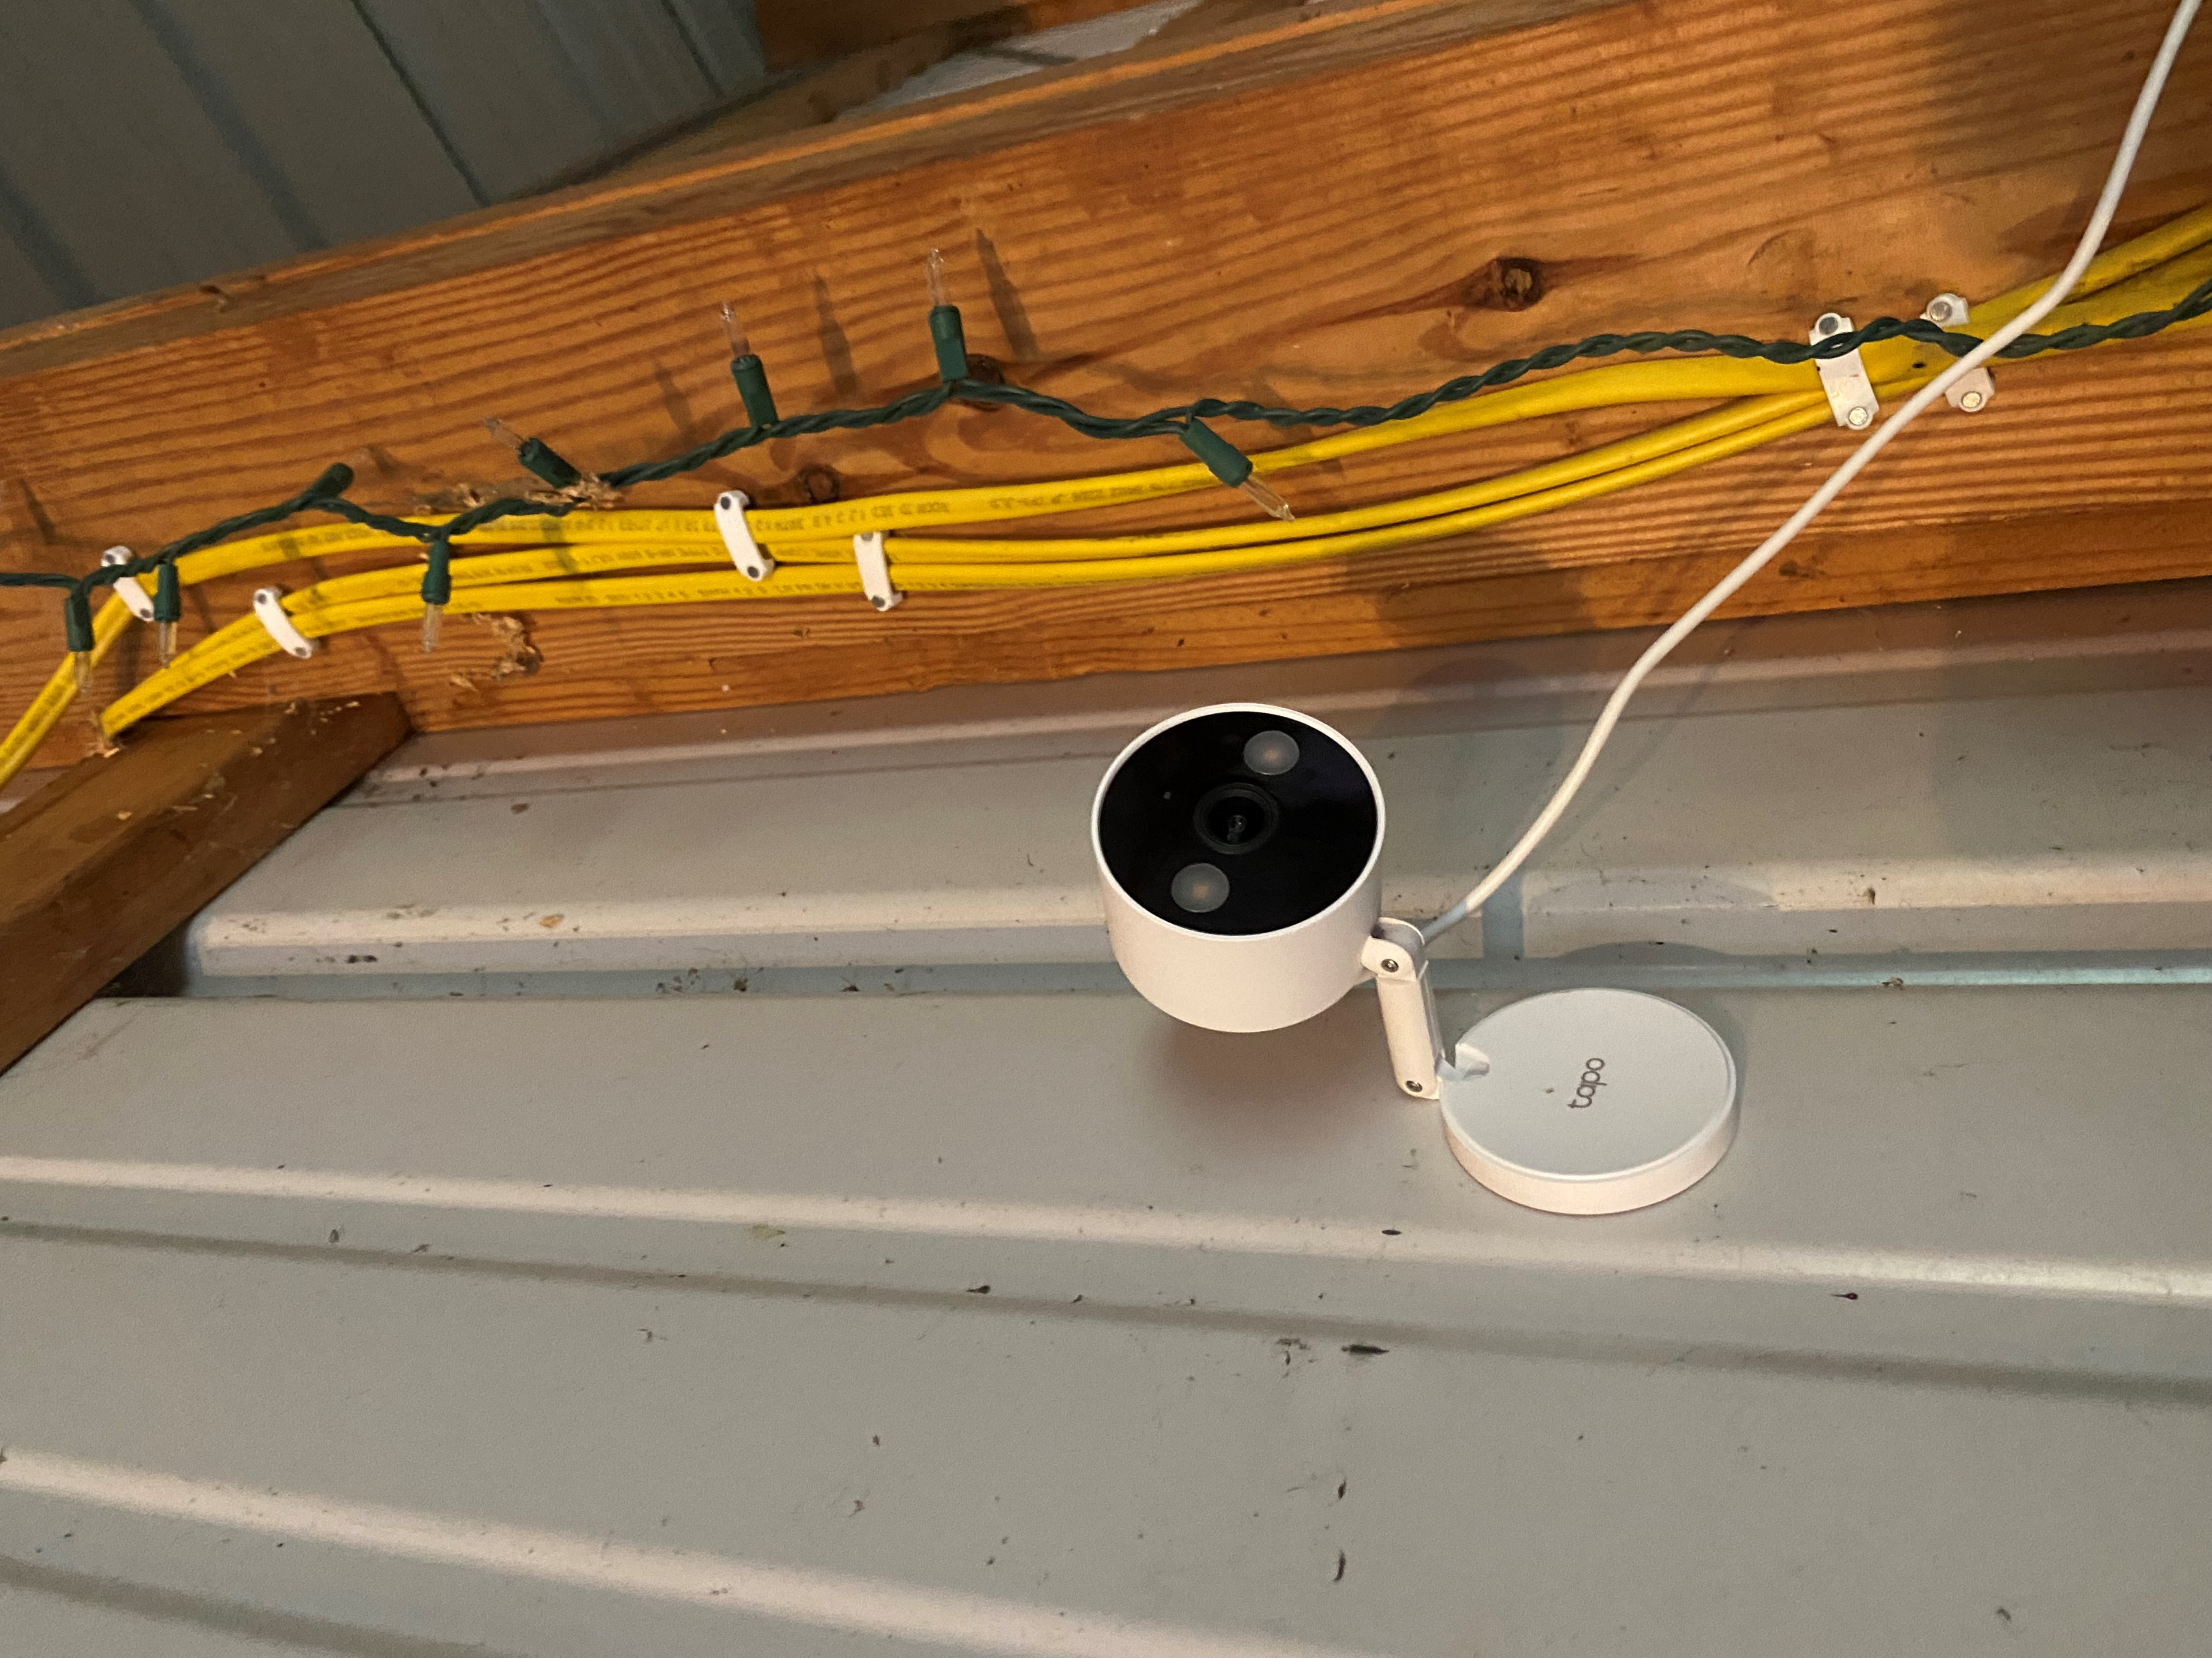
Lessons Learned
Cameras
Tapo C120
$27 on sale from $35
No luck connecting with any libraries I found… may be locked down now
Able to image capture from OpenCV and RTSP.
RTSP allows OBS Studio to use them as a media source!

Slide 86
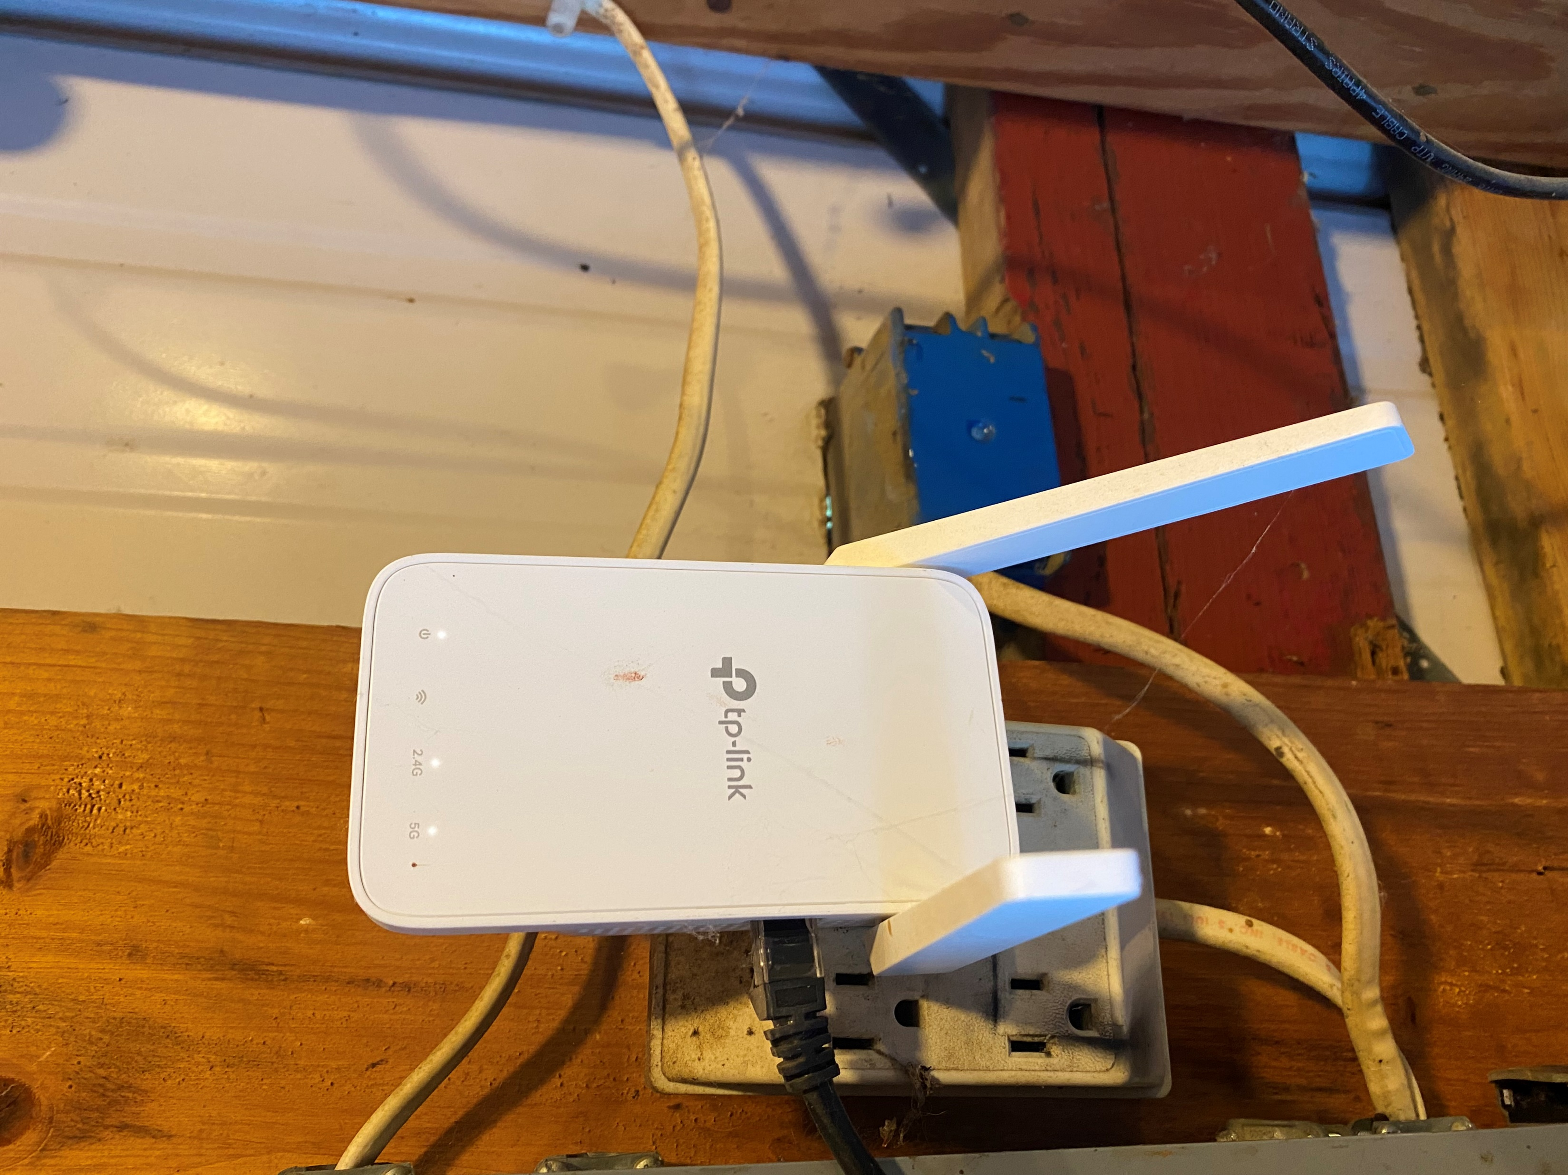
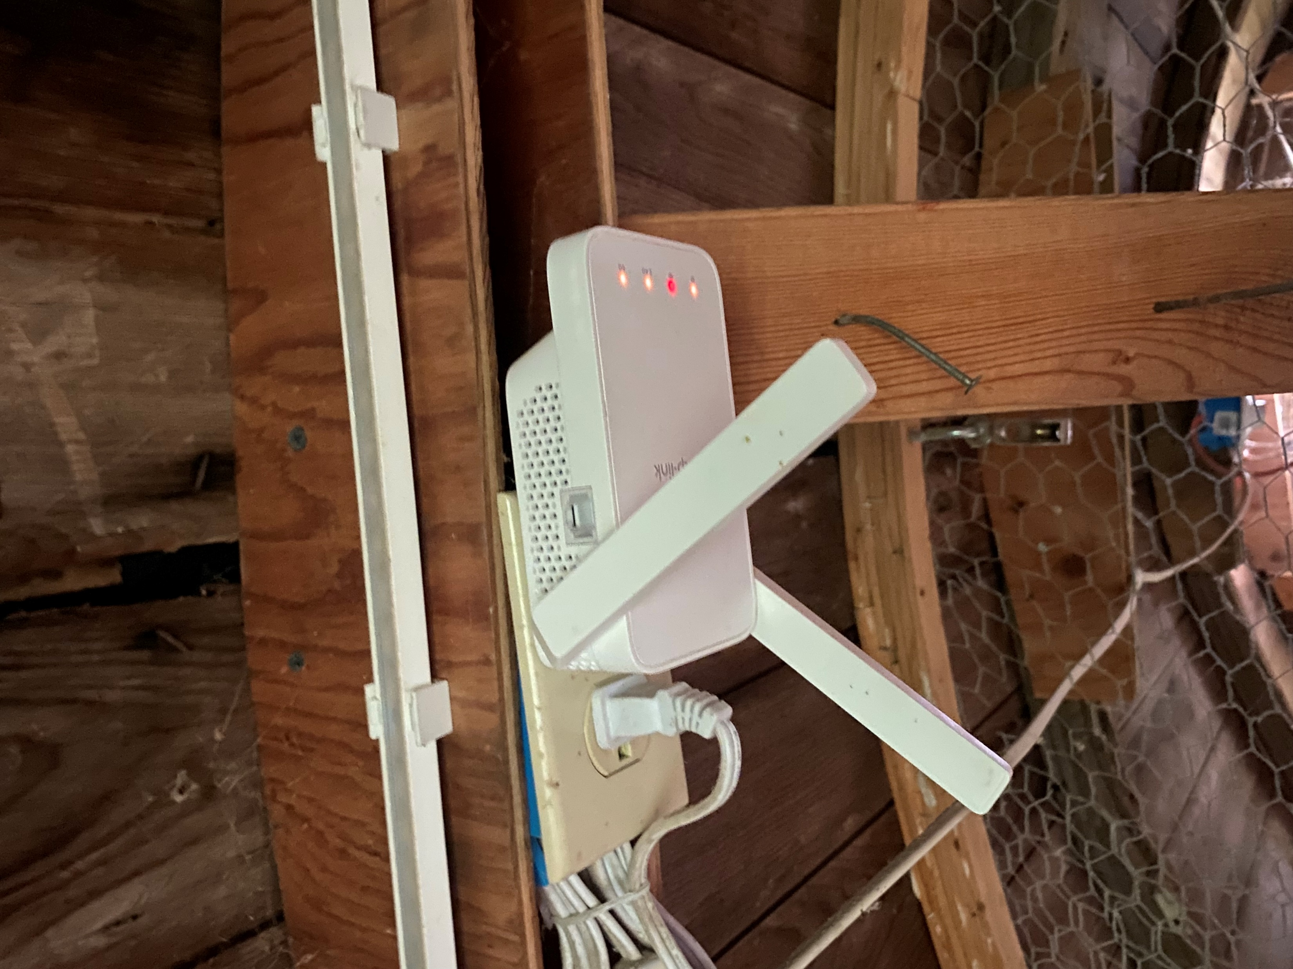
Lessons Learned
Wireless Mesh
TP-Link Archer AX73 Router
AC1200 OneMesh Wi-Fi Range Extender
Walls blocked signal, barn extender connection is hardwired
Coop extender is 50 yards from Router, works amazing

Slide 87
Notes:
Joe B

Slide 88
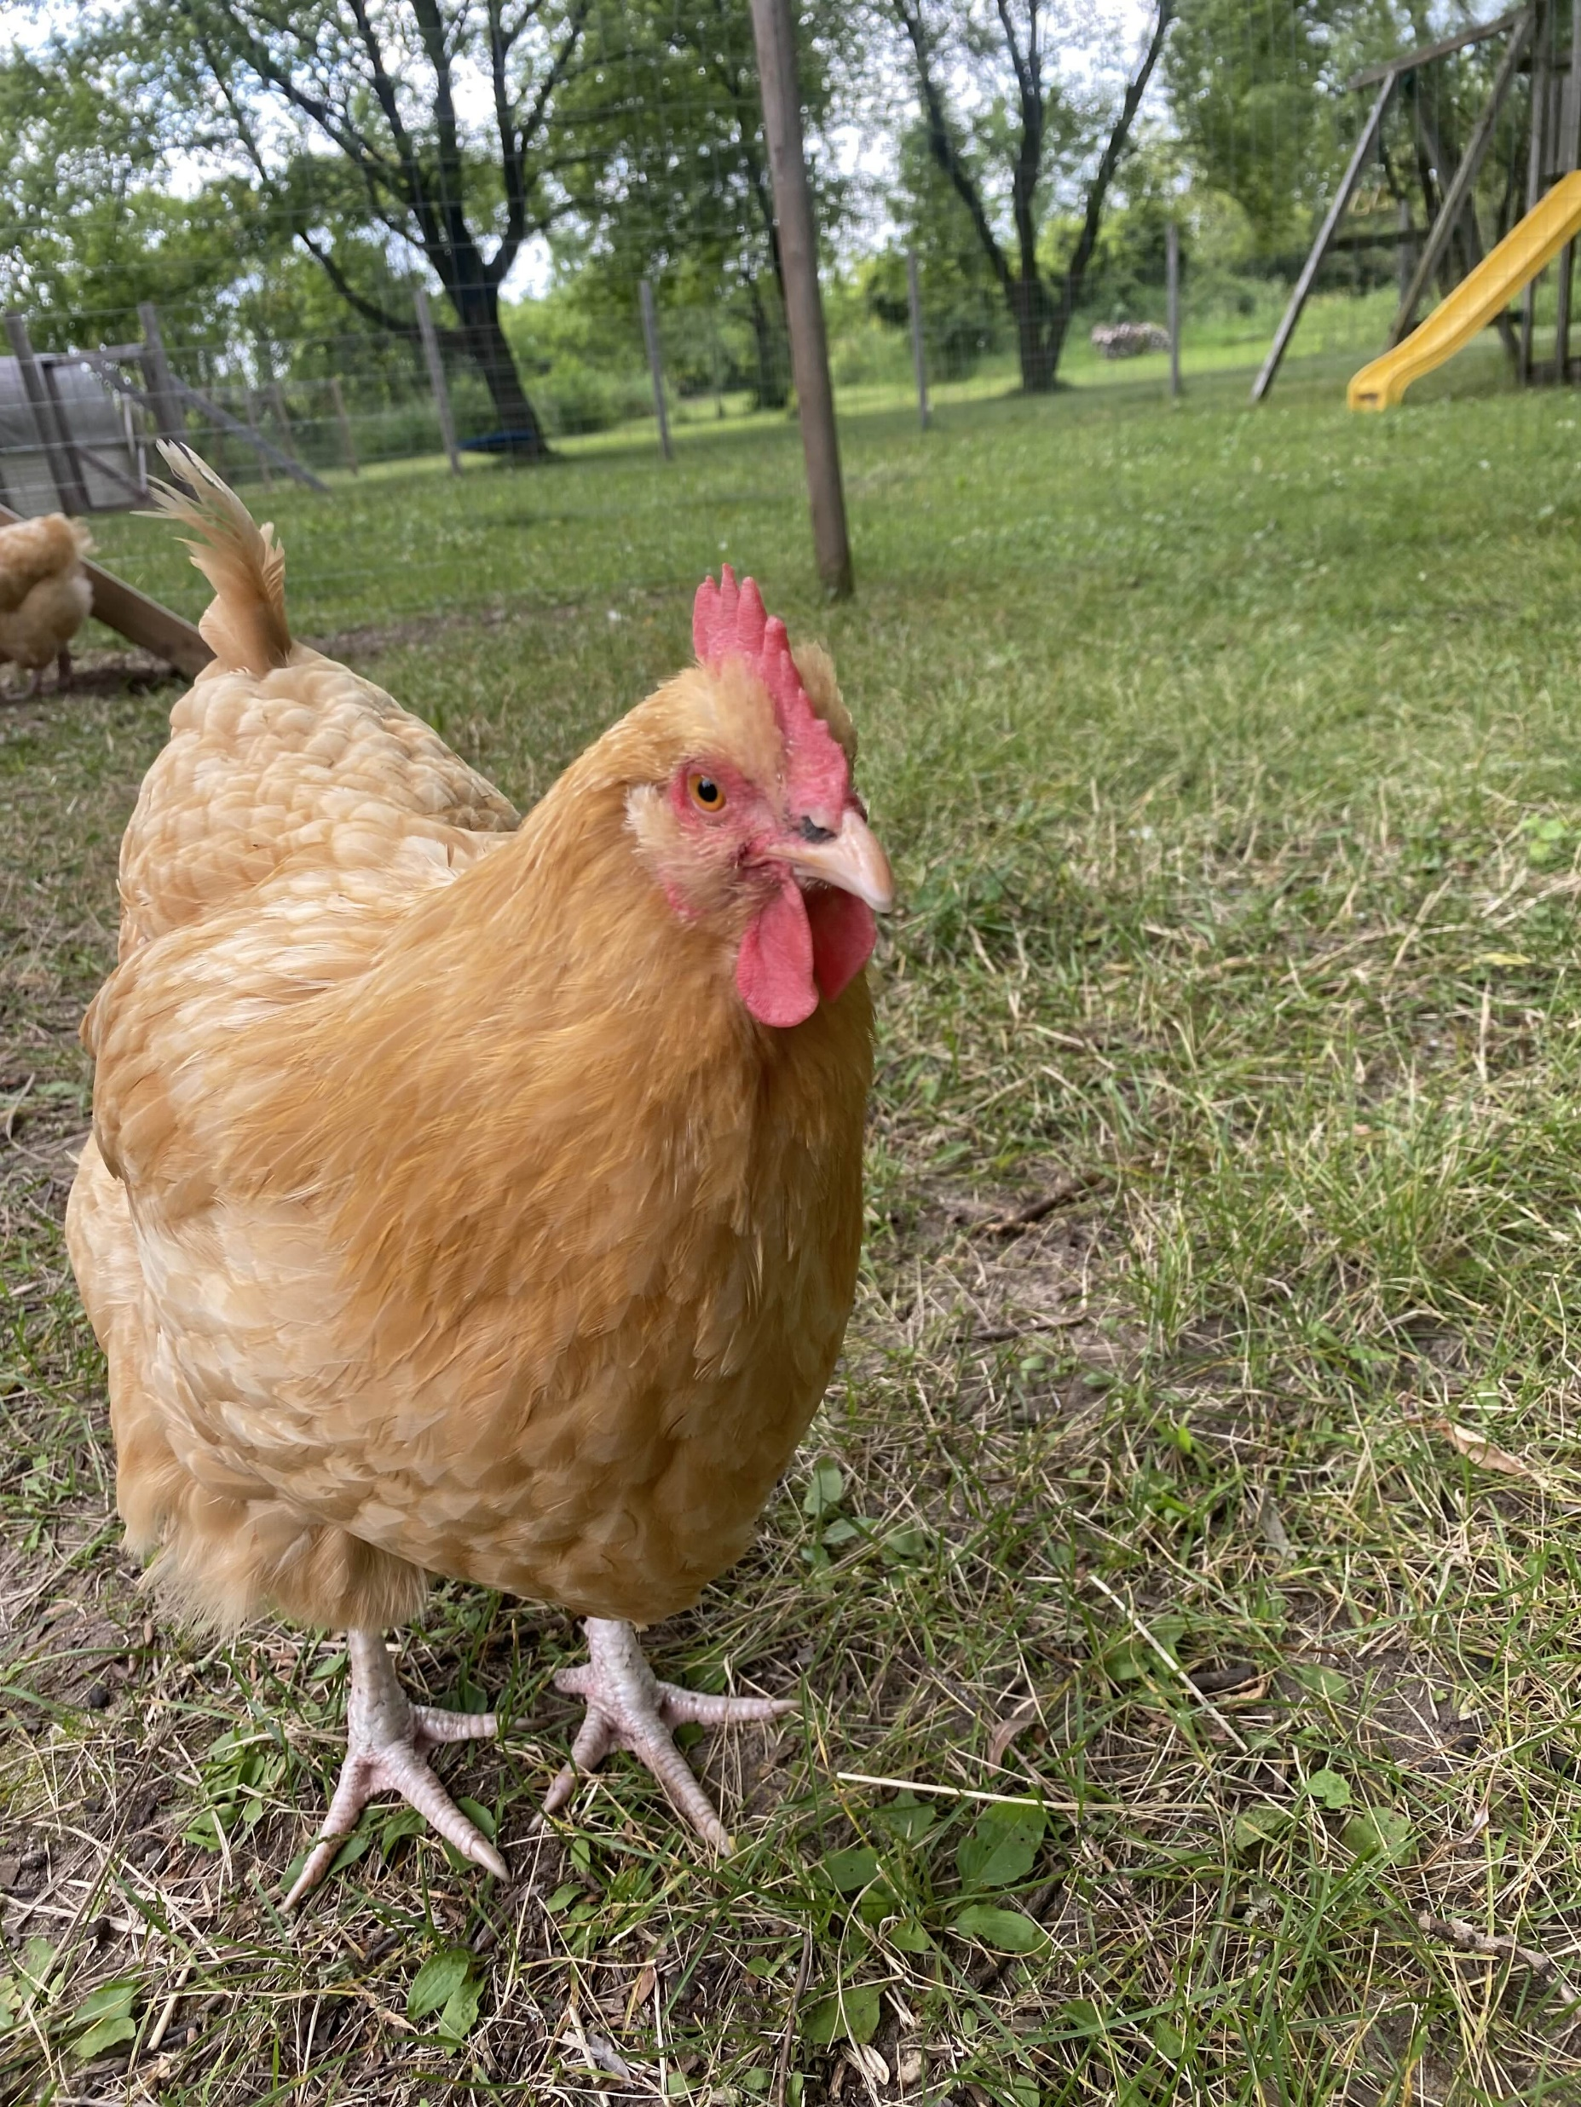
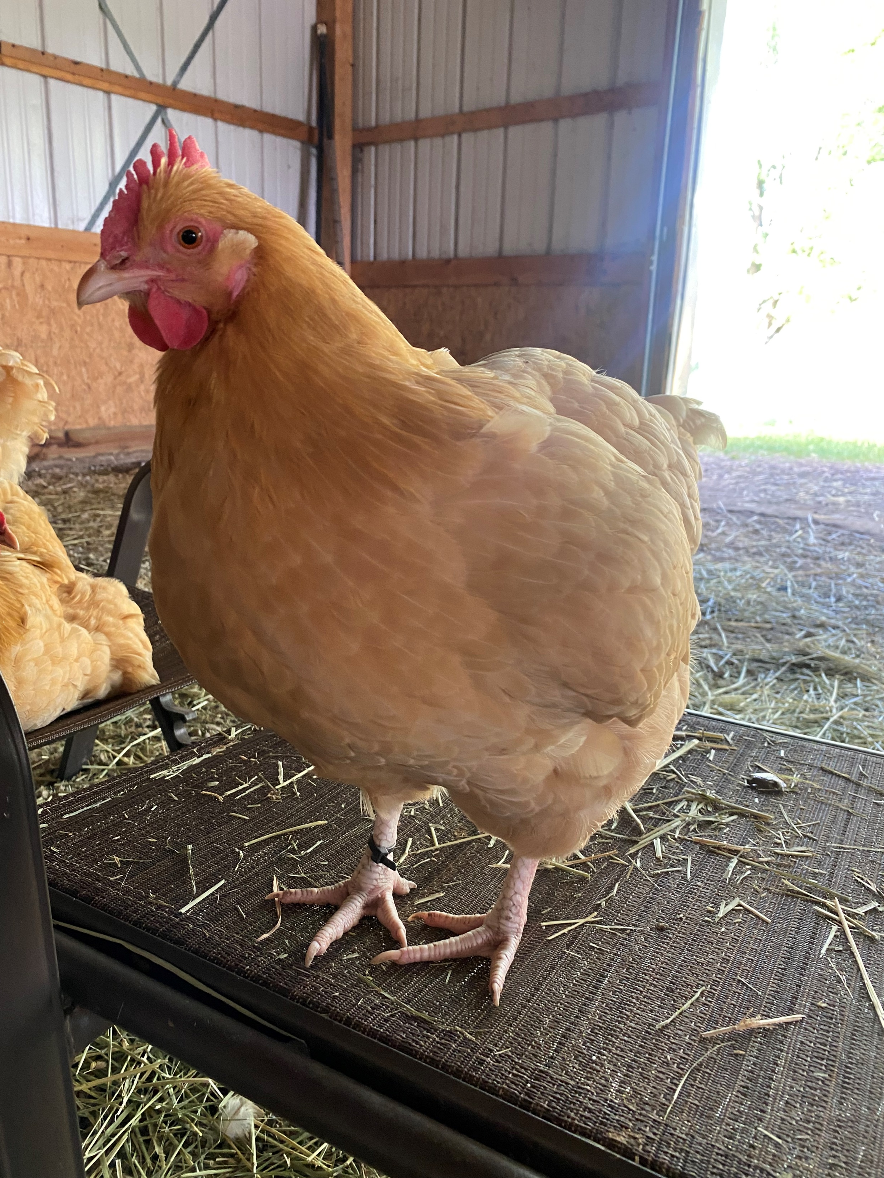
What’s next?
The Players
Christine
Susan
Lucy
Jeannie

Slide 89
Better chicken descriptions
Replace hardcoded responses/jobs with more natural responses.
Store conversation summary daily as block of text, user could ask what happened on July 1st (langchain)
Post when new job is added
Priority task posts based on device presence
Whats Next?
Better engagement

Slide 90
Refactor Bot logic into API
Use Flask instead of Express? Is performance scaling for API used by a Bot important?
Payroll
Replace google sheets
Missing Keywords background process
Image conversation context
Daily Praise
Take completed/in progress jobs and generate praise
Streaming Stories
What’s Next?
New Features

Slide 91
Detect problems (cameras offline, database offline)
Bot offline can’t tell you its offline
Who’s home to check – device presence
Cost alerts
What’s Next?
Maintenance

Slide 92
Questions?
Notes:
Joe B

Slide 93
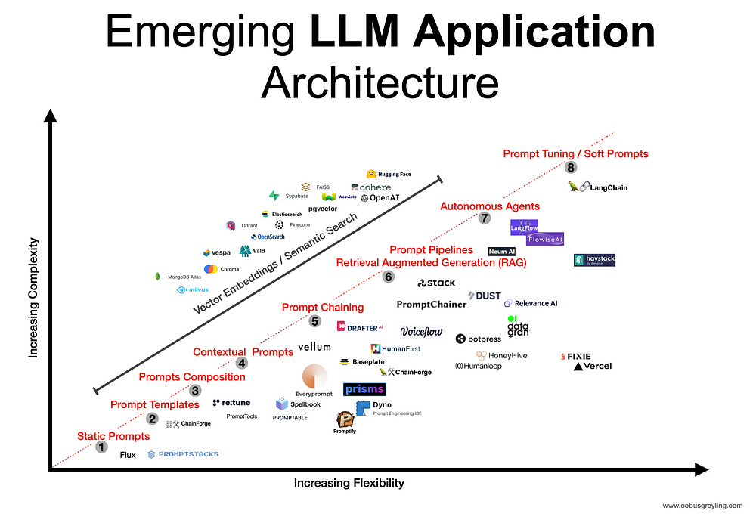
https://cobusgreyling.medium.com/emerging-large-language-model-llm-application-architecture-cba0e7862037

Slide 94

https://github.blog/ai-and-ml/llms/the-architecture-of-todays-llm-applications/

Slide 95

Decision Trees '94
GIL'S CAFE, MILWAUKEE, WI. LATE 20TH CENTURY

Slide 96
What is a user interface?
“software that is designed to allow a computer user to interact with the operating system of a machine or system”
“the space where interactions between humans and machines occur.”
AI Assist Architecture
LLMs are Text UI
https://www.merriam-webster.com/dictionary/user%20interface
https://en.wikipedia.org/wiki/User_interface

